Slide 1


Employment Benefits

Slide 2

Benefit topics we will cover-
  City Perks-
    Paid Leave
    Tuition Reimbursement
    Income Protection
    Gym Membership
    Parking/Bus Pass
  Retirement Benefits
  Core Group Benefits-
    Medical, Dental, Vision, Group Life
  Individual Benefits-
    Flexible Spending Accounts
    Long Term Disability, Accident, Cancer, Life

Slide 3
Additional topics we will cover-
  Enrollment
    Open Enrollment
    Life Events
  Eligibility
    Who can be covered
    Document requirements
  Beyond your benefits-
    Heart of the City
    The Legal Stuff
    Self-Service

Slide 4
City Perks

Slide 5

Paid Leave
  Paid Holidays
  Sick Leave
  Vacation Leave
  Sick Leave Conversion
  Sick Leave Bonus

Slide 6


Paid Holidays
  Ten (10) Paid Holidays per year-
    New Year’s Day
    Dr. Martin Luther King Birthday
    Memorial Day
    Independence Day
    Labor Day
    Veteran’s Day or Armistice Day
    Thanksgiving Day
    Day after Thanksgiving
    Christmas Eve
    Christmas Day
Which two Federal holidays are not on the list above?

Slide 7
Vacation Leave
Less than 5 years:
3 hours and 42 minutes
5 to 10 years:
4 hours and 18 minutes
10 to 15 years:
5 hours and 18 minutes
15 years or more:
6 hours and 12 minutes
Maximum vacation balance:
  Up to 10 years – 250 hours
  After 10 years – 400 hours

Slide 8
Vacation Leave Guidelines
Accrued vacation becomes available after your first six (6) months of employment
Approval for time off must be approved by your supervisor prior to using leave

Slide 9

Sick Leave
Available for use with first day of employment
  5 hours per pay period
  Return to work slip is required if out for three (3) or more consecutive days
  Sick Leave Donation-
  Employees with a sick leave balance of at least 130 hours may donate a maximum of 24 hours to employees requesting donated leave.

Slide 10
Sick Leave Bonus
Sick Leave Conversion
Employees who use less than 24 hours of sick leave during an anniversary year, will receive 16 additional hours of vacation leave
In addition, employees have the option to convert up to 40 hours of sick leave to vacation leave each fiscal year, subject to collective bargaining agreement.

Slide 11

Maximum $1,250 per semester for tuition and required fees
Full-time employees with at least one continuous year of service and who do not have grants, scholarships, veteran’s benefits or any other public or private educational benefits
Employees who resign or are terminated from employment within two years from the date of reimbursement must re-pay the City of Oklahoma City the full amount of reimbursement
(does not apply to reduction in force)
Personnel Services Bulletin 15-02
For more information contact Personnel 405. 297.2530

Slide 12
Temporary Disability Income Protection Plan (TDIPP)
Available to full time management,
executive,
city auditor, & municipal counselor pay plan employees
No cost to employee
30 day qualifying period
Pays up to 60% of salary
36 month maximum benefit
For information on using this benefit, contact Employee Benefits Manager

Slide 13

Employer Paid Parking or Bus Pass
Parking garage card or bus pass is available to employees working in the downtown area only (Subject to department approval, excludes 911/Dispatch and Municipal Courts)
Vehicle information is required on Monday morning to complete parking agreement
(Paid Parking only)
Notes:
Instruct employees to bring tag number.

Slide 14

FITNESS
  The City currently partners with two metro area fitness centers.
  City employees memberships for single member or multi-member families can be deducted through payroll deduction.

Slide 15



Basic fitness club membership - $19.00 / month.
Additional family members - $5.00 / each
Tanning and unlimited guest passes included in membership

Slide 16



Individual Membership: $19.95 + tax / month
Couple Membership: $39.90 + tax / month
Family Membership (covers up to 4 members): $65.95 + tax / month
Amenities include*
Free Child Care/Kid's Club
Exclusive Cardio Cinema (Movie Theatre)
Lap Pools
Sauna
Hot Tub
Steam Room
Basketball Courts
Smoothie Bar
*May vary by location

Slide 17
Retirement Benefits

Slide 18
Mandatory Retirement Plans
Oklahoma City Employees Retirement Systems (OCERS) – general, management and executive employees
Money Purchase Plan – management (pay plan 513 and above) and executive employees
Notes:
Mandatory contribution 6%. All pay periods.

Slide 19
Membership is required for all full-time employees
Effective on the date of your employment
  Cannot increase or decrease contribution amount

Slide 20

When can I retire?
You are eligible to retire at age 65 and 5 years of service, or –
Regardless of age if you have completed 25 or more years of service

Slide 21
OCERS
You and the City contribute to fund the plan. This is a defined benefit plan.
Your retirement benefit is based on “credited service” (2% per year) and your “average final compensation” (highest 3 out of the last 5 years).
You receive a monthly benefit payable until your death, OR a lump sum payment of up to $30,000 and a reduced monthly benefit payable until your death.
Notes:
After average final contribution refer back to going after tax.

Slide 22
Who pays for it?
Employees - 6% of your salary, excluded from Federal and State Income Taxes.
The City – variable rate.

Slide 23
What happens if I terminate employment prior to retirement?
With less than five years of credited service
You will receive a lump sum refund of employee contributions only; or
The refund may be rolled into an Individual Retirement Account (IRA).
With five or more years of credited service
You may elect a lump sum refund of employee contributions only; or
A deferred (vested) retirement in which you receive a monthly benefit at a later date.
(contact the Employee Retirement System for more details).

Slide 24
MONEY PURCHASE PLAN
Management pay plan 513 and above are eligible
Self directed investment plan
Cannot increase or decrease contribution
Administered by ICMARC
You must complete paperwork with the Employee Retirement System in order to sign up.

Slide 25
Who pays for it?
Employees - 6% of your salary, excluded from Federal and State Income Taxes.
The City – 7%

Slide 26
What happens if I terminate employment prior to retirement?
With less than five years of credited service
you will receive a lump sum refund of EMPLOYEE contributions; or
the refund may be rolled into an Individual Retirement Account (IRA).
With five or more years of credited service
you may elect a lump sum refund of EMPLOYEE and EMPLOYER contributions at the time of termination.
Contact ERS for additional options..

Slide 27


457 Optional Retirement Plans
The 457 plan a deferred-compensation retirement plan that is available for governmental and certain non-governmental employers in the United States. The employer provides the plan and the employee defers compensation into it on a
pre-tax basis.

Slide 28

BREAK

Slide 29
Core Group Benefits

Slide 30

BENEFITS EFFECTIVE DATE
Coverage begins on the first day of the month following the first full month of full-time employment excluding the month of hire.
Notes:
Tell employees the exact date their benefits become effective.

Slide 31


DECLINING COVERAGE
Employees may choose to decline any voluntary benefit.

Slide 32

EAP
Employee Assistance Program
Confidential Professional Counseling
  Anger Management Career Management
  Child or Elder Care Depression & Anxiety
  Family Issues Financial Issues
  Grief and Bereavement Legal Consultation
  Stress Management Substance Abuse
Six free sessions per family member per incident
Anyone living with you is eligible to use EAP
  Toll Free: 800-343-3822 Teen Line: 800-334-8336 TDD: 800-448-1823 Registration Code: AWP-OKC-2151

Slide 33

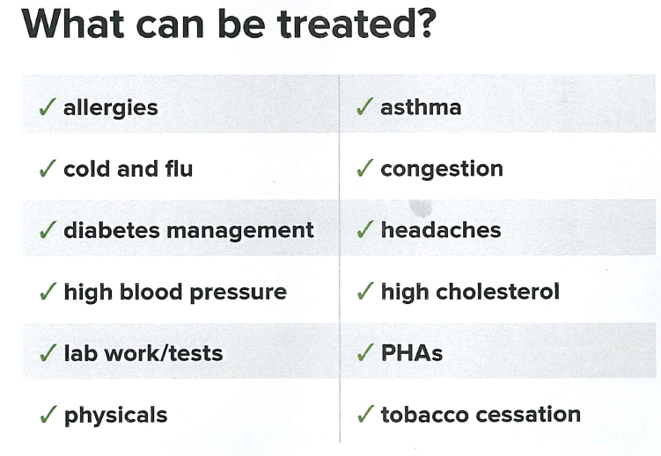
Full service primary care
  No co-pay
  No deductible
Minimal waiting room time
On-site generic prescriptions at no cost
On-site lab draws at no cost
All care received is completely confidential !!!!

Slide 34


Slide 35

SEEKING CARE
$$$
Emergency Room
Inpatient Care
No Cost
OKC Care Employee Medical Center
EAP
$$
Urgent Care
Specialist
Outpatient Care
$
Telemedicine
Primary Care

Slide 36

Controlling Costs and
Maximizing Care
Ask for generic medications when possible.
  Some newer retail medications are nothing more than two generic medications combined or time release versions. The cost of two generic or non time release medications maybe a fraction of the cost of the brand name.
Shop pharmacies for best deal and/or discount programs.
  This may not save you directly, but like above, this may result in significant savings for the plan. While copays maybe the same between pharmacies, ingredient cost can vary (sometimes significantly) from one pharmacy to another.
  Some pharmacies also have discount programs that allow you to get certain medications at a lower copay without any cost back to the plan.
Controlling Costs

Slide 37

Controlling Costs and
Maximizing Care
Utilize OKCCare Employee Medical Center.
  This is a no cost benefit for employees and dependents enrolled in either medical plan. You can receive primary care as well as certain generic prescriptions at no cost.
  In addition, lab work is completed each year and can be forwarded to your primary care doctor, saving the plan money
Utilize preventative care and wellness benefits regularly.
  The earlier you seek care and a condition is diagnosed, the easier and less costly it is to treat.
  In addition, better outcomes are possible with early diagnosis.
Utilize the necessary type of care for the condition being treated.
  You will cost yourself time and money as well as the plan money by utilizing emergency services for non-emergency services.
Controlling costs and maximizing care do not have to be mutually exclusive!!!
Maximizing Care

Slide 38
PRESCRIPTION FORMULARY
A Formulary is a list of medications that are covered under the plan.
Each medication class is represented in the formulary.
It is important to verify your medications are on the formulary.
If your medication is not listed on the formulary, the medication WILL NOT BE COVERED
Notes:
Stress importance of using primary care physician.
Can self refer to specialist provided they are in-network.

Slide 39
My medication is on the formulary….
However,
What is Step-Therapy and
Prior Authorization?
Prior Authorization
A prior authorization is a requirement that the physician obtain approval prior to prescribing a specific medication.
Your physician will be responsible to submit the required documentation.
Step Therapy
Some medications require that alternatives have been prescribed and are ineffective or not appropriate treatment options.
Your physician will be responsible to submit the required documentation.

Slide 40
Which Plan is Right for Me?
Important items for review when deciding which medical plan to choose:
Provider list
Formulary list
Summary of Benefits and Coverage
Plan Premium Cost
Notes:
Explain to employees the formulary. Importance of verifying current prescriptions are covered.

Slide 41

HMO HEALTH PLAN
Administered by

Slide 42

HMO
Highlights include
No deductible/co-insurance
$30 co-pay for primary care, specialist, and urgent care
$100 in-patient co-pay hospitalization
Self Referral for In-Network Specialist
Prescription drug coverage
  $15 generic
  $30 preferred brand
  $65 non-preferred brand
Mail Order Benefit
  90 day supply for 2 copays
All covered individuals must live within the HMO service area
Notes:
Explain to employees the formulary. Importance of verifying current prescriptions are covered.

Slide 43
PRIMARY CARE PHYSICIAN (PCP)
Did you know? To maximize care and reduce cost, always utilize your PCP for initial care. In cases of an emergency, utilize urgent or emergency care.
Please verify your primary doctor and any specialists are in-network. The plan will NOT cover charges from non-network providers.
If you do not select a primary care physician, one will be assigned to you based on your location. You will contact UHC to make any future changes to your PCP.
HMO
At benefit enrollment, the member may select a Primary Care Physician from www.myuhc.com.
Notes:
Stress importance of using primary care physician.
Can self refer to specialist provided they are in-network.

Slide 44


URGENT CARE
NON LIFE THREATENING medically necessary health care services required to PREVENT THE SERIOUS DETERIORATION of a member’s health resulting from an unforeseen illness or injury for which treatment SHOULD NOT be delayed. Your Primary Care Physician should be contacted for further instructions.
Important Fact:
Primary and most Urgent Care services will not be covered outside of the UHC service area.
Examples:
Fever, Sprains, Flu, Infections (after hours, weekends)

Slide 45

EMERGENCY CARE
A serious LIFE THREATENING medical condition which REQUIRES immediate care and/or treatment. The primary care physician must be contacted WITHIN 48 hours.
Important Fact:
Emergency Care is covered outside HMO service area
Examples:
Stroke, Heart Attack, Broken Arm/Leg.

Slide 46

CHOOSING NETWORK PROVIDERS
EXAMPLES:
Amy goes to her primary care physician for treatment of migraines and is prescribed a generic medication. Amy should expect to pay $30 for the office co-pay and $15 at the pharmacy for the generic medication.
John is in an automobile accident and seriously injured. John is admitted to the hospital and has several surgeries as a part of his recovery. The total billed charges for the hospital stay is $150,000. John pays a $100 copay.
The HMO plan provides offers a low co-pay and no co-insurance for covered services with in-network providers.
This will result in low out of pocket expenses.
If you go out-of-network (with the exception of emergency care out of the HMO service area), the HMO plan will not cover these services.
Notes:
Explain chart and how before tax can increase take home pay. Explain benefit of going after tax prior to retirement.

Slide 47
HMO
Have additional questions?
Additional information and resources are available at:
www.myuhc.com
Summary of Benefits and Coverage
Employee Guide to Benefits
UHC Customer Service

Slide 48


PPO HEALTH PLAN
(Group Indemnity Plan)
Administered by

Slide 49


GROUP INDEMNITY
PPO HEALTH PLAN
Deductible / Coinsurance plan
  $250 Individual Deductible
  $1,000 Co-Insurance
  $1,250 Total Individual Out of Pocket Maximum
Out of network coverage with separate deductible, coinsurance
  $3,300 Total Individual Out of Pocket Maximum
Greater physician choice flexibility, no PCP required
Prescription Plan - Prime Therapeutics
  $15 generic
  $30 brand
Mail Order plan
  90 day supply for 2 copays
Important Fact:
BCBS offers members Nationwide coverage
Notes:
In network Deductible $250 ind/$500 family. After deductible is met, plan pays 90% in-network up to a out of pocket max of $1000.
Total in-network out of pocket should not exceed $1250 per year.
Pre-existing condition excludes minors and those who have not had a greater than 62 day gap in coverage in the past year. Proof of prior coverage may be required to be sent to BCBS.
Those with pre-existing conditions not excluded, BCBS will pay a max of $4000 for the first year.
Open formulary. Exceptions may include supplements(vitamins) and experimental drugs.

Slide 50
Why should I use a Blue Preferred provider?
PPO
John goes to a in-network general practice provider for treatment of an ulcer. The provider bills BCBS $150 for the visit. John pays a $15 copay and since he has met his deductible pays an additional $10 in coinsurance of the allowable charges of $100.
What if John had not met his deductible? John would pay the $100, which would apply to the deductible.
What is John’s total responsibility if he had in-network claims totaling $10,000? John would pay $1,250. After this amount the plan pays at 100%.
Provider list: www.bcbsok.com/okc
Notes:
Blue choice network is large. Most providers are contracted.
If you go out of network there is a separate deductible ($300 ind/$900 family) and out of pocket maximum ($3000 per individual) that has to be met. Plan pays 70%.

Slide 51
What happens if I choose an Out-of-Network provider?
PPO
Sue goes to an out-of-network dermatologist for a consultation. The provider bills BCBS $200 for the visit. Sue pays a $15 copay and since she has met her out-of-network deductible pays $30 of the allowable charges of $100. In addition, Sue may owe an additional $100 to the provider for the difference in billed charges for a total of $145.
What if Sue had not met her deductible? Sue would pay the $200, which would apply to the out-of-network deductible.
What is Sue’s total responsibility if she had $10,000 in out-of-network claims? Sue would pay $3,300. After this amount the plan pays at 100%.
Notes:
Blue choice network is large. Most providers are contracted.
If you go out of network there is a separate deductible ($300 ind/$900 family) and out of pocket maximum ($3000 per individual) that has to be met. Plan pays 70%.

Slide 52

PPO
Have additional questions?
Additional information and resources are available at:
www.bcbsok.com/okc
www.myprime.com
Summary of Benefits and Coverage
Employee Guide to Benefits
BCBS/Prime Therapeutics Customer Service

Slide 53

Health Comparison
Plan
Selection of Doctors | Primary Care Physician | Choose from Blue Preferred network | Non-Blue Preferred & Out of network
Individual Deductible | $0 | $250* | $300*
Coinsurance Max. | N/A | $1,000* | $3,000*
Office Co-pay | $30 | $15 + 10% of charges | $15 + 30% of charges
In-patient Hospital | $100 | $50 + 10% | $50 + 30%
Out-patient Hospital | $50 | $50 + 10% | $50 + 30%
Emergency Room Visit | $50 / Waived if admitted | $50 + 10% | $50 + 30%
Preventative Care | Plan pays 100% | Plan pays 100%
*Accumulators for each deductible and coinsurance are separate
Notes:
Review of plans. Refer employees to pages 17 thru 19 in the Benefits Handbook for Health Plan Comparison.

Slide 54

HEALTH BENEFIT QUESTION & ANSWER

Slide 55
GROUP LIFE
Administered by

Slide 56

GROUP TERM LIFE INSURANCE
The City provides $15,000 Basic Life / $5,000 AD&D at no cost to the employee. The employee has the option to purchase additional group life insurance:
Optional Term Life - $5,500
Voluntary Term Life – .5x/1x/2x/3x Salary
Supplemental AD&D - $5,000 - $20,000
Spouse Term Life - $10,000 - $100,000
Child Term Life - $2,500 - $10,000*
* Benefits under Child Life will reduce to $100 during the first six months after birth.
Did you know?
Group Life rates are based on group rates and not based on age.
The term of policy is the term of employment.
Notes:
Explain advantages of signing up as new hires.
Optional life .63 per pay period.
Supp life- based on salary (refer to enrollment form for rates). Up to 2x guaranteed issue for new hires. 3x does require EOI, will enroll in 2x until approval is received.
Spouse life – 20K guaranteed issue for new hires. EOI required for additional amounts.
AD&D - .08 per pay period.
Child life – guaranteed issue for all amounts for new hires.

Slide 57

POLICY HIGHLIGHTS
Guarantee Issue - No Evidence of Insurability (EOI) for new hires (up to 2x Salary for employee, $20,000 for spouse)
Conversion Available
Portability Available (Voluntary Life only)
Accelerated Death Benefit
Maximum Life – $500,000
Why is guaranteed issue important?
If you and/or spouse have a medical condition that would exclude you or make it cost prohibitive from purchasing life insurance, now is the time to consider electing life coverage as a new hire.
The City offers upon retirement the option to elect a $10,000 Retiree Life policy
Notes:
Accelerated death benefit – less than year to live, plan pays 50% of benefit. Other 50% upon death.

Slide 58

BENEFIT REDUCTION
Benefits under the Group Life Insurance will reduce base on your age:
Age 65 - 65% of currently elected coverage
Age 70 - 40% of currently elected coverage
Age 75 - 25% of currently elected coverage
Fact:
Benefit Reduction does not apply to retiree group life coverage.
Notes:
Accelerated death benefit – less than year to live, plan pays 50% of benefit. Other 50% upon death.

Slide 59

LIFE BENEFICIARIES
Attached to your enrollment form is a beneficiary designation forms for Group Life, Final Wages, and Retirement.
Please complete all beneficiary forms prior to enrollment on Monday.
Fact:
You can update beneficiary information at any time.
It is recommended that you provide updated beneficiary information periodically.

Slide 60

LIFE BENEFICIARIES
You can designate a primary beneficiary(ies) and/or contingent beneficiary(ies):
If you designate more than one primary beneficiary, the percentage total for primary beneficiaries must equal 100%.
If you designate more than one contingent beneficiary, the percentage total for contingent beneficiaries must equal 100%.
Important:
A contingent beneficiary will only receive life insurance proceeds in the event of the death of employee as well as the death of all primary beneficiaries.
Why do I need to consider purchasing additional life insurance?
Each employees needs are different in regards to life insurance. Life insurance could be considered as income replacement for your beneficiaries to help bridge any loss of income due to an unexpected death.

Slide 61


Which life insurance option is best for me?
Group Life -
Rates based off of group rates, not age
Guaranteed issue for new hires
Typically lower premium cost
Individual Life -
Purchase in 10, 20, 30 year terms
Rate stays the same throughout term
Upon separation of employment, policy can be converted to direct bill for the same rate.
Ability to reissue policy at end of term. Rate will change based on your current age.
Notes:
Accelerated death benefit – less than year to live, plan pays 50% of benefit. Other 50% upon death.

Slide 62
LIFE INSURANCE
QUESTION & ANSWER

Slide 63

Flexible Spending Accounts
Long Term Disability
Accident Insurance
Individual Term Life
Cancer Insurance
Notes:
This slide is a placeholder for these programs. AFA should be presenting them for NEO.

Slide 64
DENTAL PLAN
(Group Indemnity Plan)
Administered by

Slide 65

DENTAL BENEFITS
Preventive Care (includes basic exams and cleanings with deductible waived)
Select a different dentist for each member of your family
Change dentists at any time
Same low deductible for both options:
  $50 individual/$150 Family
Did you know?
Prior to receiving a course of treatment over $300, your dentist will need to submit a predetermination to BCBS for approval.
Failure to submit a predetermination may result in the claim being denied!
Additional dental information and network providers can be found at: www.bcbsok.com/okc
Notes:
Preventive care (exams) covered 100%

Slide 66
What is the low option?
The LOW option maximum benefit is $1,000 per participant per calendar year. This is typically sufficient for basic and routine dental care.
Highlights include:
Depending on the level of service, the plan will pay a percentage with the remaining percentage your responsibility.
In-network is paid at a higher percentage than out-of-network. You may be balanced billed for out-of-network services.
Orthodontic benefit is capped at $1,000 lifetime per participant.
Notes:
Preventive care (exams) covered 100%

Slide 67
What if I need more dental coverage than the Low option?
The HIGH option offers a maximum benefit is $1,500 per participant per calendar year.
Highlights include:
Depending on the level of service, the plan will pay a percentage with the remaining percentage your responsibility.
Endodontic & Periodontal are covered at a higher percentage (80%)than the low option (50%).
In-network is paid at the same percentage than out-of-network. However, You may be balanced billed for out-of-network services.
Orthodontic benefit is capped at $1,200 lifetime per participant.
Can I switch between the Low and High option?
Each year at Open Enrollment, you have the opportunity to switch between the low and high option depending on your current dental needs.
Notes:
Preventive care (exams) covered 100%

Slide 68

VISION PLAN
Administered by

Slide 69

VSP VISION CARE
PLAN FEATURES
Examination - once every calendar year ($10 copay)
  Lenses/Frames – once every calendar year ($25 copay for lenses, $170 frame allowance)
  Additional copays for progressive lens options ($55-$175)
  20-25% savings on non-covered lens options
OR
  Contacts – once every calendar year ($150 allowance)
  Contact fitting and evaluation (up to $60 copay)
20% discount for additional complete set of glasses
Discount for laser vision correction surgery
Provider list available at www.VSP.com
Fact:
The HMO medical plan offers one eye exam per calendar year, but no allowance for glasses or contact lenses.
Notes:
Refer to Benefits Handbook page 25 for Benefit Summary.
Contacts or lenses(not both)-once per year
Glasses (VSP Choice provider)- $10 exam copay. Lenses $25 copay. $130 frame allowance.
Contacts- $130 contacts and fitting ($40 -60 usual)

Slide 70
DENTAL AND VISION BENEFIT QUESTION & ANSWER

Slide 71
Eligibility

Slide 72

WHO ARE ELIGIBLE DEPENDENTS?
Spouse as defined by Oklahoma State law.
Common Law Spouse as recognized by the State of Oklahoma. Additional documentation is required.
Children as defined by Oklahoma state law or who qualify as a dependent under the Internal Revenue Code.
Adult child(ren) who are physically or mentally incapable of self support at the time they would otherwise lose coverage.

Slide 73
WHO QUALIFY AS CHILDREN
Natural, and/or Adopted child(ren).
Stepchild(ren) who qualify as a dependent under the Internal Revenue Code.
Other child(ren) for whom the employee is the legal guardian.
Child(ren) under the age of 26.
Disabled Child(ren) over the age of 26 incapable of self-support.
Contact Employee Benefits for additional requirements for disabled dependent qualification

Slide 74

DEPENDENTS DO NOT INCLUDE….
Ex-Spouse & Ex-Stepchildren
In-laws, Parents, Siblings, etc.
Any other person who does not qualify as a dependent under the Internal Revenue Code.

Slide 75

WHAT DOCUMENTS DO I NEED TO BRING TO ENROLL A SPOUSE AND/OR DEPENDENT CHILD(REN)?
Eligibility will NOT be established until the following are received:
  A copy of the SOCIAL SECURITY CARD for each eligible dependent;
And one of the following documents:
  A copy of your MARRIAGE CERTICATE for your spouse;
  A copy of the STATE ISSUED BIRTH CERTIFICATE for each dependent child;
  A copy of the COURT ORDER establishing legal adoption or guardianship.
No Documents = No Coverage

Slide 76


LIFE EVENTS
Notes:
Qualifying events allow for mid-plan year changes. No qualifying event = no mid year plan changes.

Slide 77

WHAT IS A LIFE EVENT?
Marriage / Divorce
Birth /Adoption / Gain Legal Custody
Dependent’s change in status (employment)
Employee or Spouse changes employment status
Death
Significant change in premium cost or coverage attributable to spouse’s employment
New residence inside/outside of HMO service area
Questions???? Contact Employee Benefits
Life Events allow changes to be made to your elections during the plan year. Some life events, such as a divorce, require you to make a change. Other life events are voluntary, meaning it is your choice to make changes.
Notes:
Change has to be consistent with event. For example, birth of child does not allow spouse to be added. Or loss of medical coverage does not allow changes to be made to vision.

Slide 78

I just had a life event…
All qualifying Life Event changes must be made within 31 days of the qualifying event.
AND
You must provide Employee Benefits supporting documentation for qualified change.
Important:
Any changes made must be consistent with the life event. For example, a birth of child does not allow you to add your spouse to coverage.
Notes:
Give examples of failure to notify us timely. Benefits are here to answer any questions you may have. If you think you have had a qualifying event and may need to make changes, it is vital to contact us within 31 day after the event. However if you wait outside of 31 days, we may not be able to help you or make the changes requested.

Slide 79
I failed to notify Employee Benefits of my Life Event within 31 days…
In this case, you may have to wait until the next Open Enrollment period to make changes.
OR
If you maintain coverage for an ineligible dependent due to a Life Event, the employee may be subject to disciplinary action and/or legal action to recoup premiums or claims paid on behalf of the ineligible dependent.
Notes:
Give examples of failure to notify us timely. Benefits are here to answer any questions you may have. If you think you have had a qualifying event and may need to make changes, it is vital to contact us within 31 day after the event. However if you wait outside of 31 days, we may not be able to help you or make the changes requested.

Slide 80

WHAT IS OPEN ENROLLMENT?
Each year the City of Oklahoma City provides an Open Enrollment period. This event allows employees the opportunity to:
  Add/drop/change health, dental, life or vision plans
  Increase/decrease life insurance
  Add/drop qualified dependents
IMPORTANT:
No qualifying life event is necessary to make Open Enrollment changes
Notes:
Life insurance and LTD require EOI completed for open enrollment elections.

Slide 81
OPEN ENROLLMENT
A new Employee Guide to Benefits and election form will be mailed to you each year with important information and changes.
It is your responsibility to review the information provided and make changes within the enrollment period.
Fact:
Open Enrollment period is held in October of each year.
Changes made are effective January 1st of the following year.

Slide 82

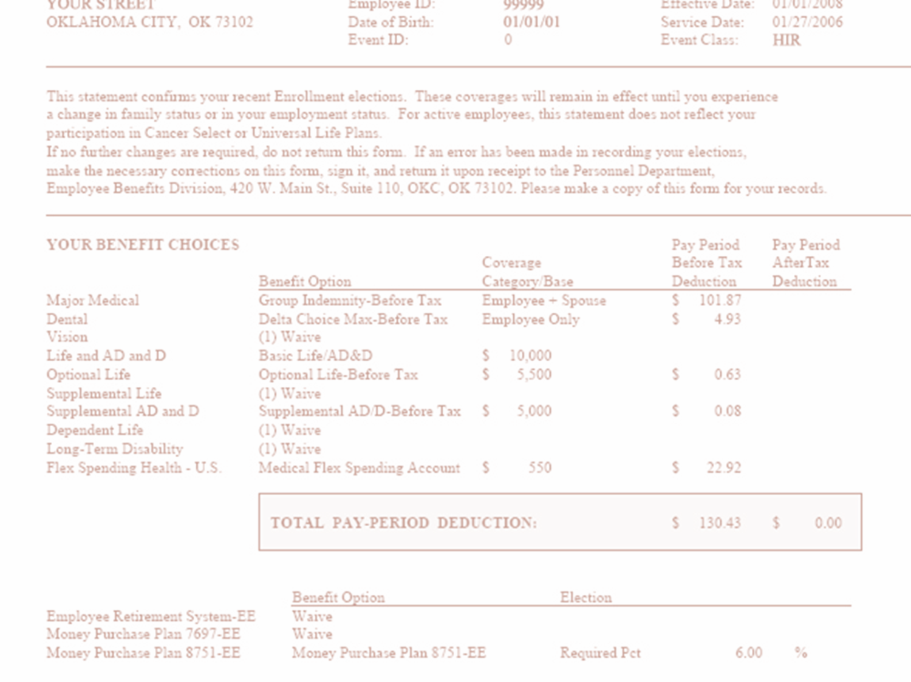
CONFIRMATION OF ELECTIONS
A Confirmation of Elections will be mailed to you each year after Open Enrollment period closes typically at the end of October.
It is your responsibility to review the confirmation provided and notify Employee Benefits IMMEDIATELY of any corrections.
Note:
You will receive Confirmation of Elections following your elections as a New Hire as well as anytime changes are made due to a Life Event.

Slide 83
Enrollment

Slide 84
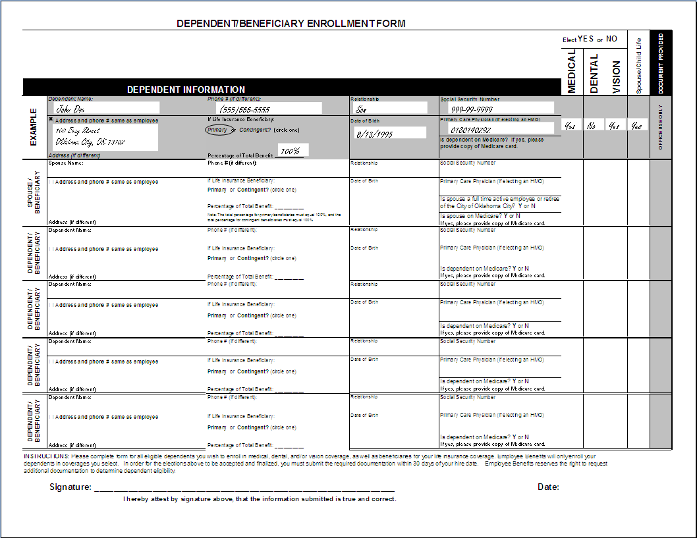

DEPENDENT INFORMATION FORM
Note: You will only need to complete if you are electing medical, dental, vision, and/or life coverage for spouse and/or dependent children.
Notes:
Explain procedure to complete form. Instruct them to have form completed before enrollment on Monday. Detail differences between dependents and beneficiaries.

Slide 85
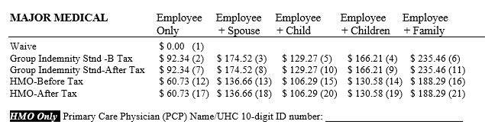

MAKING YOUR ELECTIONS
Plan Options
Tier Levels
Premium
(Employee Portion)
Primary Care Physician
(HMO only)
Circle the ( ) of the election you wish to make.
Example: If you wish to waive coverage, circle (1).
Notes:
Explain how to determine correct rate. Instruct employees to circle plan they wish prior to enrollment on Monday.

Slide 86
WHAT IS A BEFORE - TAX OPTION?
A Before - Tax Option (also called Section 125 or Cafeteria Plan) allows you to have your group insurance premiums deducted from your paycheck before taxes.
This means you pay no federal or state tax on your premium contributions, resulting in more take home pay.
Deductions must all be either before or after tax, if applicable.
Before-tax seems to make the most sense. Why would I choose after-tax?:
Your retirement benefit with OCERS is calculated on adjusted gross earnings. If you have large pre-tax benefit deductions, you may wish to select after-tax at least 3 years prior to retirement. Contact OCERS for additional information.
Notes:
Exception is for LTD. The City permits after tax deductions for LTD if you otherwise elect before tax.

Slide 87
Why pre-tax my elections?
Pre-Tax Example |  | After-Tax Example
$30,000.00 | Gross Salary | $30,000.00
-$4000.00 | Pre-Tax Deductions | -$0.00
$26,000.00 | Adjusted Gross Salary | $30,000.00
-$5200.00 | Estimated Federal Tax (20%) | -$6000.00
-$1980.90 | Estimated FICA (7.65%) | -$2281.50
$0.00 | After-Tax Deductions | -$4000.00
$18,801.10 | Take-Home Pay Difference | $17,718.50
$1,082.60 | Change in take home pay | -$1,082.60
Notes:
Exception is for LTD. The City permits after tax deductions for LTD if you otherwise elect before tax.

Slide 88
ENROLLMENT PACKET
The enrollment packet has valuable information and forms; please take the time this weekend to read over the information and complete and sign the attached forms. Please circle the plans you wish to elect on the enrollment form.
Even if you are not electing coverage for spouse or dependent children, you should still designate beneficiaries for Group Life Insurance, Final Wages, and Retirement. Regardless of any elections you make, these will all still apply.
DO NOT FORGET TO BRING ENROLLMENT FORM BACK ON MONDAY!!!

Slide 89
Beyond Your Benefits

Slide 90


Municipal Employees Charitable Contribution Campaign
You may select a $2.00 per pay period minimum payroll contribution
Annual fundraising drive in September of each year by Oklahoma City employees that benefits local charities
The choice to contribute is voluntary
A one-time contribution

Slide 91



Municipal Employees Charitable Contribution Campaign
When renewed during the Heart of the City campaign, contributions may be allotted to the charities of your choice.
Supports 50 non-profit organizations that meet health and human service needs of the community.
The Allied Arts supports 20 metro area arts organizations and their artists who help shape and enhance our cultural landscape. At well over 4,000 artists, Allied Arts represents one of the largest artist communities in the country.
Notes:
United Way of Central Oklahoma supports 50 non-profit organizations that meet health and human service needs of the community.
Examples: American Heart Association, American Red Cross, Big Brothers Big Sisters of Oklahoma
Allied Arts supports 20 metro area arts organizations and their artists who help shape and enhance our cultural landscape. At well over 4,000 artists, Allied Arts represents one of the largest artist communities in the country.
Examples: Arts Council of OKC, Canterbury Choral Society, Oklahoma City Museum of Art

Slide 92


Represents 17 health agencies that provide research, programs and services to prevent, manage and cure chronic and life-threatening health conditions.
Regional Food Bank provides enough food to feed more than 90,000 hungry Oklahomans each week.

Slide 93
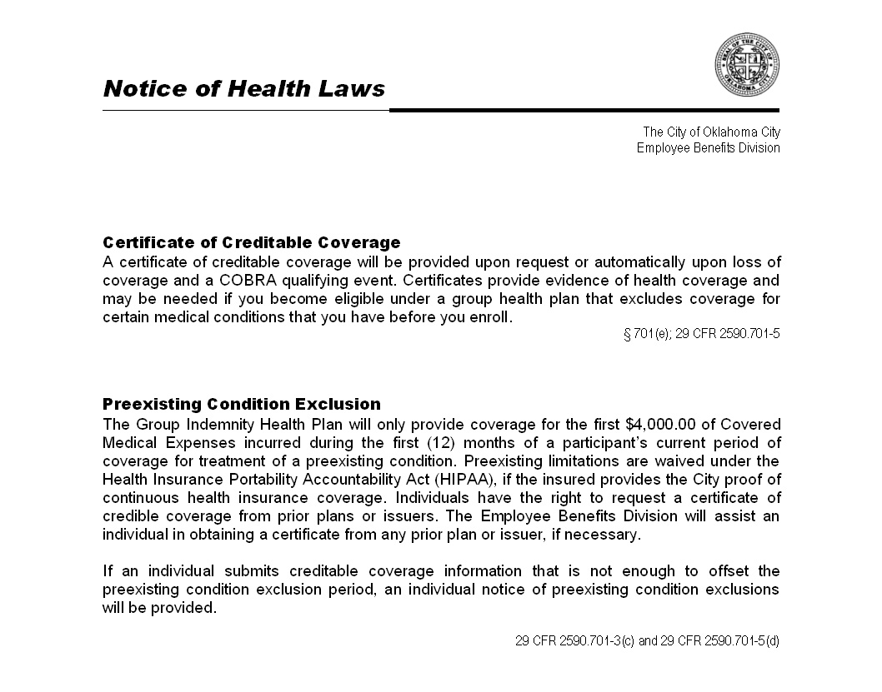

NOTICE OF HEALTH LAWS
In your enrollment packet is an acknowledgement of receipt that you will need to compete.
Notes:
Please sign notice acknowledgement in your enrollment packet.

Slide 94
NOTICE OF HEALTH LAWS
Certificate of Creditable Coverage
Affordable Care Act
Special Enrollment Rights
Notice of Privacy Practices

Slide 95

AFFORDABLE CARE ACT
Health Insurance Marketplace
Must maintain coverage for a minimum of 9 of the 12 months
Individual Mandate
- City plans meet standards
More information on exchanges and eligibility for discount can be found at:
  www.healthcare.gov

Slide 96

COBRA
Continuation of Coverage
General Notice (Informational)
Election Notice
Election must be made 60 days of qualifying event
Employee and/or family member
Coverage period of 18-36 months depending on qualifying event.
Have additional 45 days from election date to make payment
90 days of effective date of hire
Employee/Spouse
Temporary Continuation of Benefits
Notes:
Cobra –allows you to continue coverage for up to 18 months after loss of coverage. Responsible for total premium. Refer back to cost of plans earlier.
Election notice must be returned within 60 days of qualifying event. Payment must be made within 45 days of election.

Slide 97

PEOPLESOFT SELF-SERVICE
Personal Information
Benefits
View current benefits
Open Enrollment elections
Compensation/Payroll
View/update demographic info
View paychecks
Paycheck modeler
Update W-4
Direct Deposit

Slide 98

CHECKLIST
Complete enrollment packet this weekend:
  Dependent Information
  Enrollment elections
  Beneficiary forms
  Sign all forms attached to Enrollment Packet
  Bring on Monday:
  Completed enrollment packet
  Copies of all required legal documents (Spouse and Children)
  Vehicle Tag Number (Downtown campus employees only)

