Slide 1
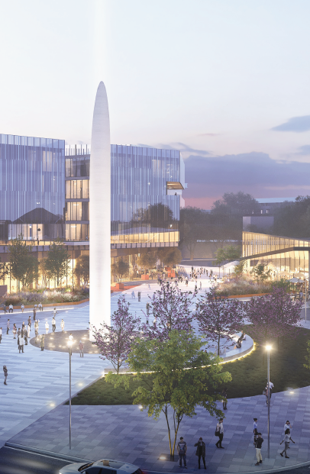
Innovation District Land Use Plan
Informational presentation
10.28.21
Questions or concerns? Please contact:
Lisa Chronister, Assistant Planning Director
Oklahoma City Planning Department
lisa.chronister@okc.gov (405) 297-1628

Slide 2
Purpose of the Land Use Plan
How the Land Use Plan will be used
What we heard from the community, and how these concerns have been addressed
Key features of the plan
Schedule and next steps
Acknowledgement

Slide 3
• Provide specific recommendations to guide new development
• Guide zoning code updates
• Guide Tax Increment Financing (TIF) incentives
• Prioritize future bicycle and pedestrian improvements
What is the purpose of the innovation district LAND USE PLAN?

Slide 4
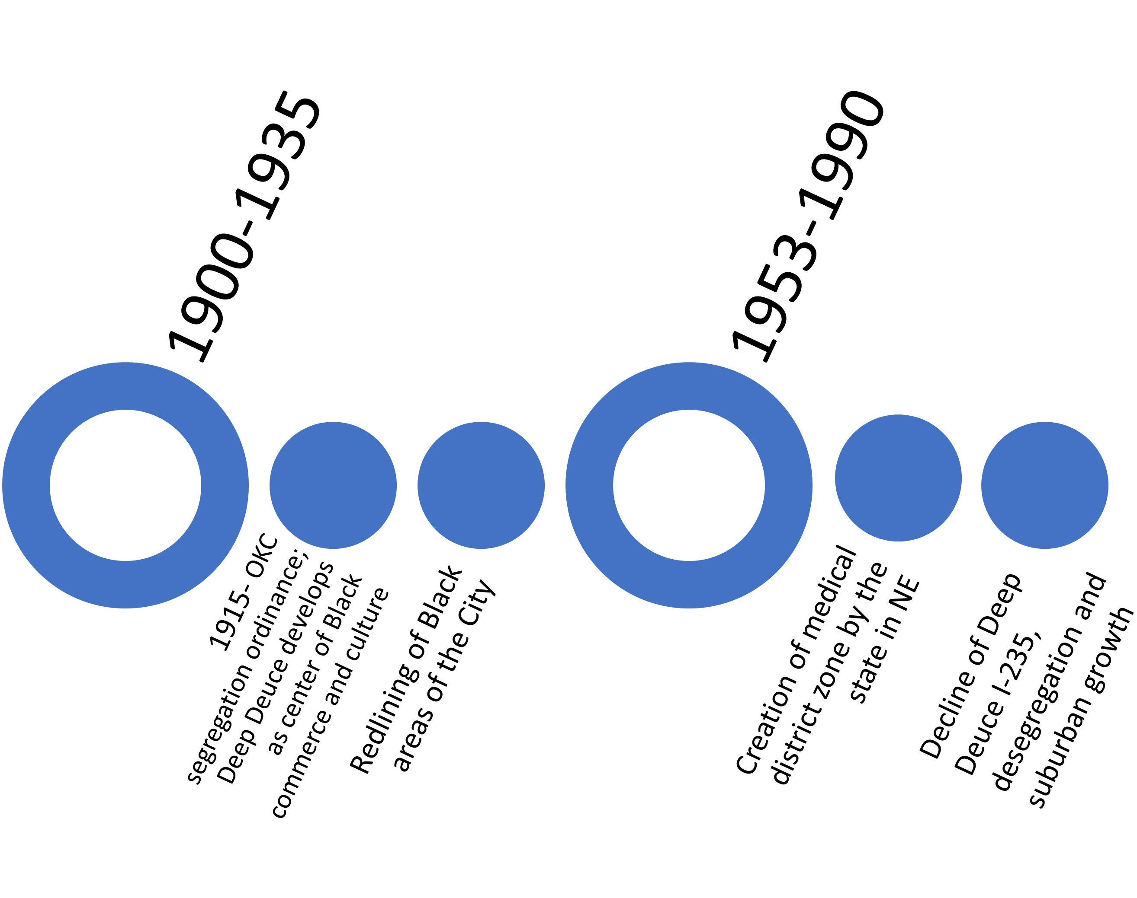
Acknowledgement
Difficult history of redevelopment and urban renewal in NE OKC.
Communities were razed and replaced with what is now much of the Health Center and I-235, disproportionately affecting historically African American neighborhoods.
City now engages the community before decisions are made.
Notes:
In 1915, OKC was one of the first cities to adopt a segregation ordinance which effectively made Deep Deuce one of the few places where Blacks could live;
in 1935 our Federal government through the Federal Home Loan Bank Board, ranked areas of major cities for lending, giving the color red, meaning “Hazardous” to majority Black areas which meant that home loans were not available in those areas, allowing many of those areas to fall into disrepair,
in the 1960s, federal programs for “urban renewal” cleared some of these areas for highways and other major projects. Significant portions of African-American communities were razed and replaced with what is now much of the Health Center (and later, I-235)
This contributed to surrounding neighborhoods being physically disconnected from other parts of the city and from health center area.
The once vibrant commercial corridor along 4th St was demolished and remains largely underutilized.

Slide 5
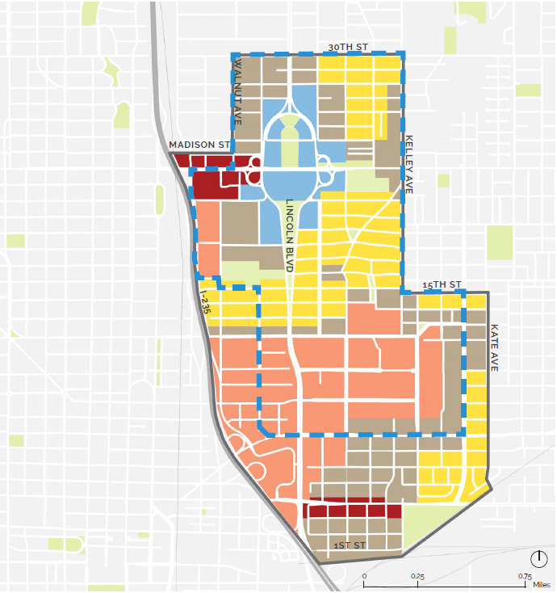
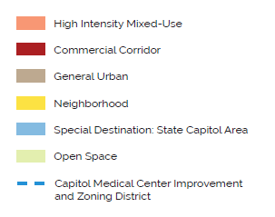
What is the purpose of the innovation district LAND USE PLAN?
• Defines land use priorities and establishes roadmap for future development

Slide 6
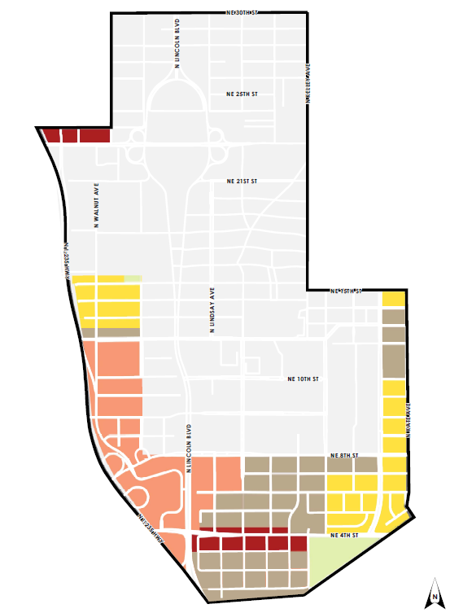
LAND USE PLAN ZONING
• Only a portion of the Land Use Plan is currently within OKC zoning

Slide 7
The Land Use Plan will not change existing zoning.
The Land Use Plan will not require property owners to make any changes to their existing property.
The Land Use Plan will be used to review future rezoning proposals when they occur.
Any future rezoning proposals will require public hearings at Planning Commission and City Council. Surrounding property owners will be notified of any hearings.
How will the innovation district LAND USE PLAN be used?

Slide 8
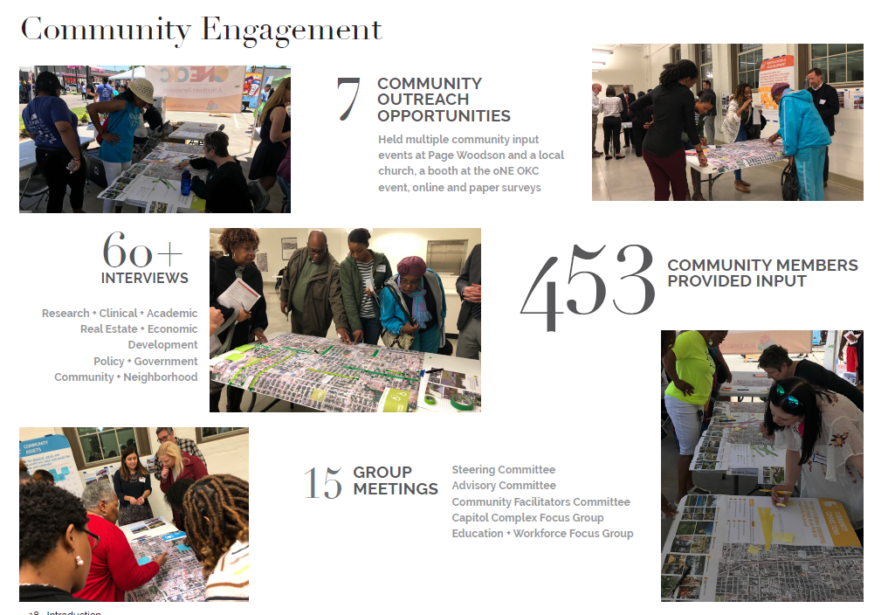
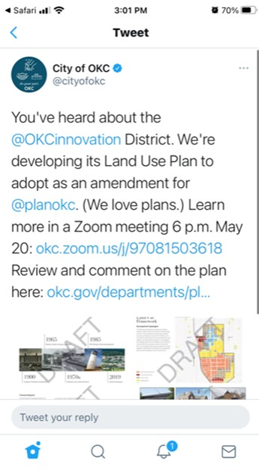
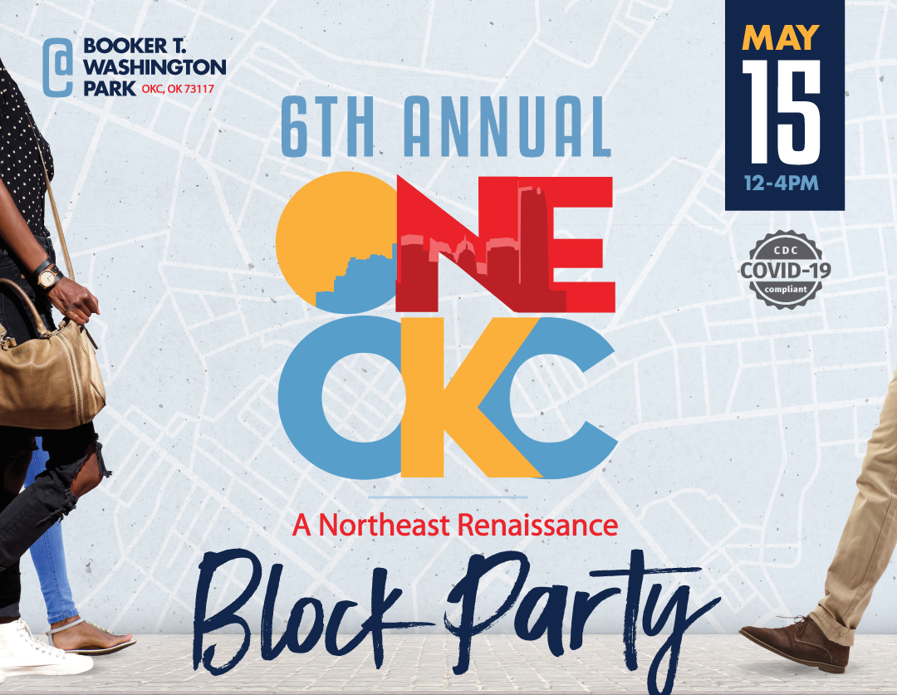
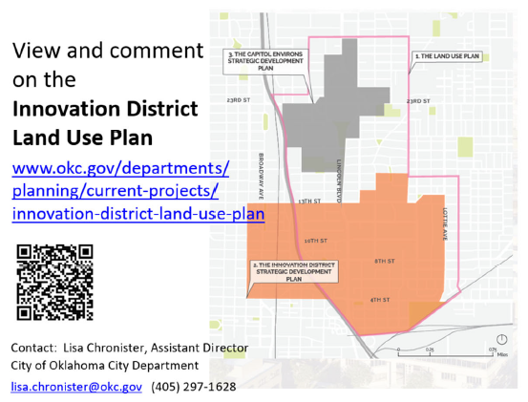
Community Outreach
2018
2020

Slide 9
What we heard
• What does the plan do for neighborhoods?
• The Harrison-Walnut Neighborhood is shown too dense
• What does the plan do to keep housing affordable?
• What does the plan do to support Black-owned businesses?
• Why does the plan cut off my neighborhood?
• How can residents have a voice in what gets built in their neighborhood?
Notes:
The plan was limited in scope to land use planning.
As mentioned previously, the land use plan will help buffers neighborhoods from traffic and noise by locating busier uses closer to I-235 and Lincoln Blvd, and by planning quieter buildings (medium-density) next to neighborhoods
The land use plan encourages protection and revitalization of existing parks, such as improvements and activities to Booker T. Washington Park)
Connects neighborhoods to services and employment by planning a network of safe and comfortable streets for all users, regardless of how they travel: cars, bike lanes, sidewalks, lighting, and public transit.
Proposed street types were developed from community engagement held by Perkins and Will and planokc recommendations (p. 36)

Slide 10
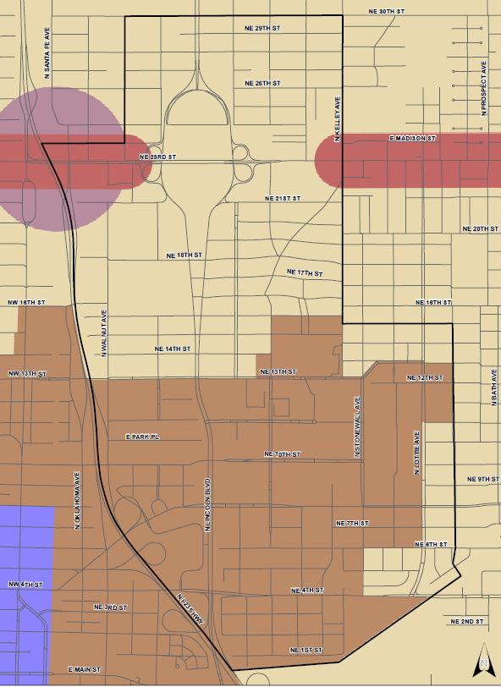
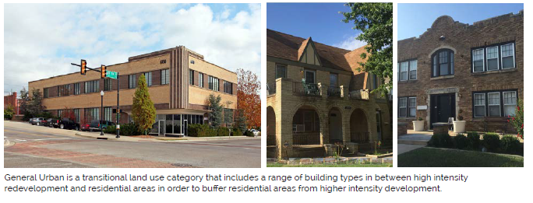
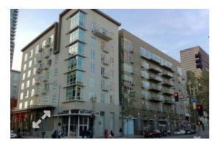
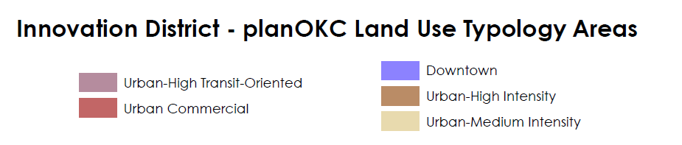
What does the plan do for the neighborhoods?
Response:
Recommends less development intensity in some areas than planokc
Urban High Intensity:
3 stories minimum
General Urban:
2 to 4 stories
Proposed Land Use Plan

Slide 11
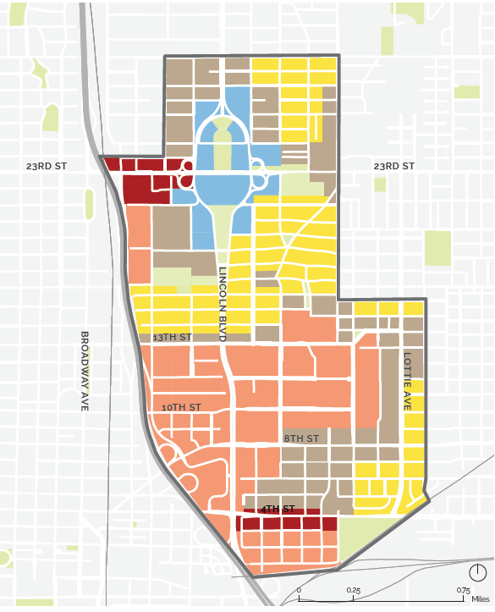
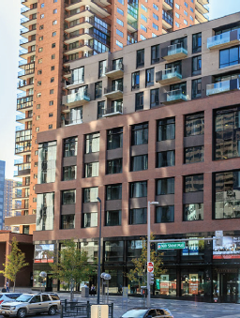
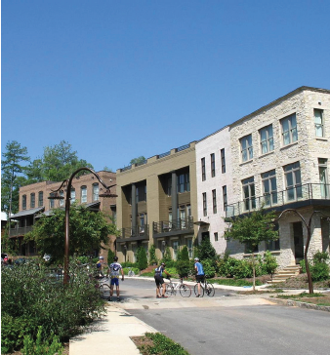
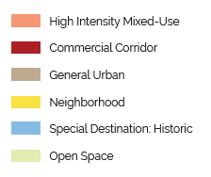
Harrison-Walnut Neighborhood is shown too dense
Response:
Change from High Intensity Mixed-Use to General Urban
what will the land use plan do for neighborhoods?
Plan draft as shown at meetings
Summer 2021
Plan draft as shown at PC Meetings
Summer 2021
Notes:
As mentioned previously, the land use plan will help buffers neighborhoods from traffic and noise by locating busier uses closer to I-235 and Lincoln Blvd, and by planning quieter buildings (medium-density) next to neighborhoods
The land use plan encourages protection and revitalization of existing parks, such as improvements and activities to Booker T. Washington Park)
Connects neighborhoods to services and employment by planning a network of safe and comfortable streets for all users, regardless of how they travel: cars, bike lanes, sidewalks, lighting, and public transit.
Proposed street types were developed from community engagement held by Perkins and Will and planokc recommendations (p. 36)

Slide 12
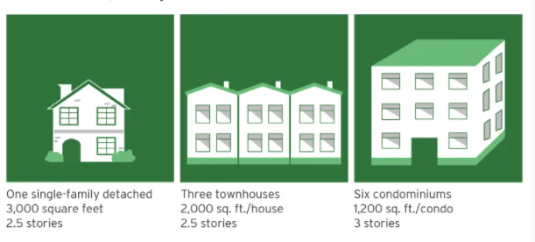
What does the plan do to keep housing affordable?
Response:
Promotes increased density and a variety of housing types
Example
One single-family
    $50,000 lot
    $150/sq ft to build
    Total cost per unit is $500,000
Three townhomes
    $50,000 lot
    $150/sq ft to build
    Total cost per unit is $316,000
Six condominiums
    $50,000 lot
    $150/sq ft to build
    Total cost per unit is $188,330
Notes:
Where land is expensive, building more homes per parcel increases affordability
Adding more homes in single-family neighborhoods makes it possible for more people to move into the neighborhood (and city).
New homes can also improve affordability, because the cost of the most expensive factor—land—is spread across more homes.
Improving housing options also enables better matching between the size of one’s house and the size of one’s household;
Image: https://www.brookings.edu/research/gentle-density-can-save-our-neighborhoods/

Slide 13
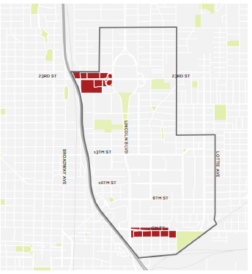
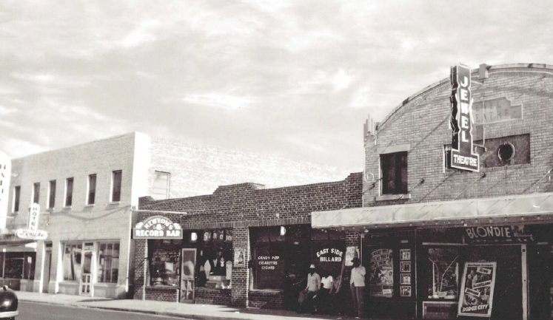
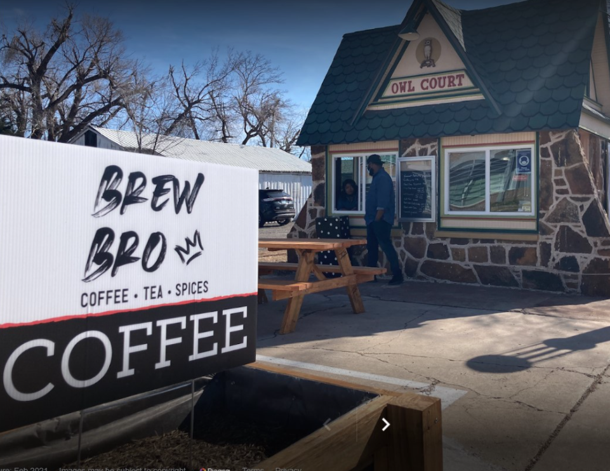
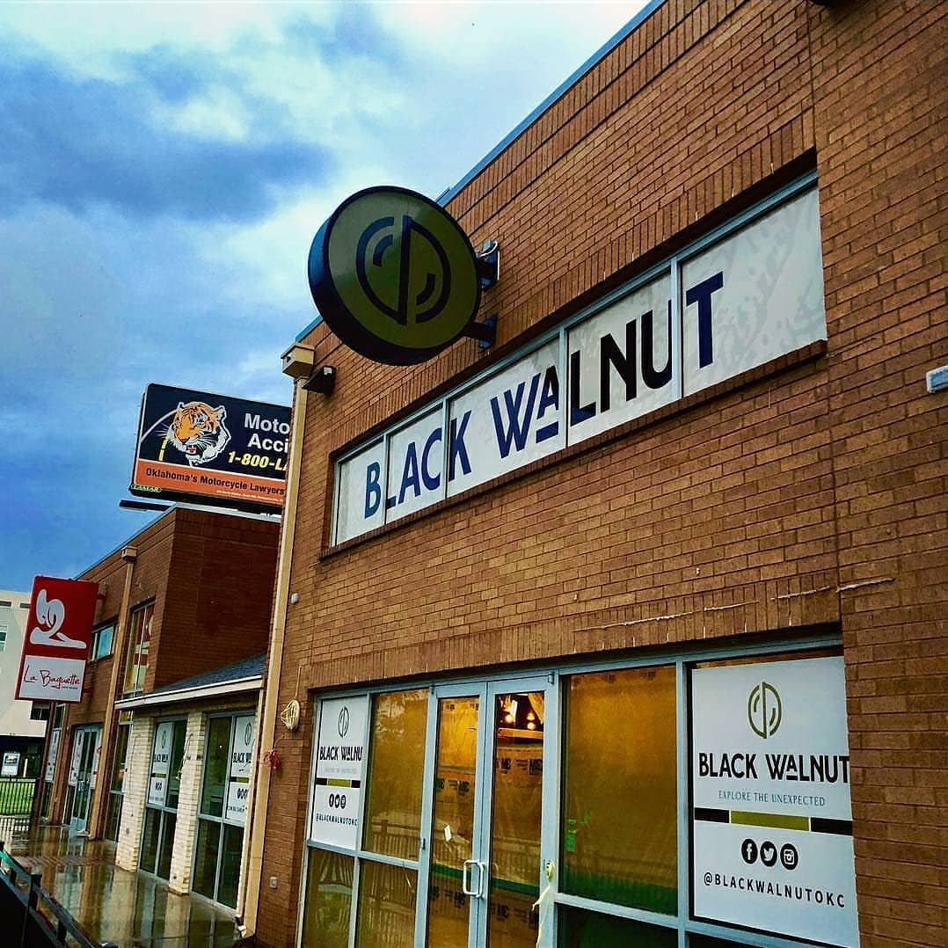
What does the plan do to support Black-owned businesses?
Response:
◦ Promotes increased density
◦ Designates areas for retail destinations
◦ Includes building design guidelines for retail, dining, service, and entertainment uses
◦ Connects customers to services with a network of safe and comfortable streets for all users
Notes:
Local businesses depend heavily on foot traffic
Identifies areas for centrally located retail destinations
Provides building design guidelines for retail, dining, service, and entertainment uses
Provides for access by coordinating a network of safe and comfortable streets

Slide 14
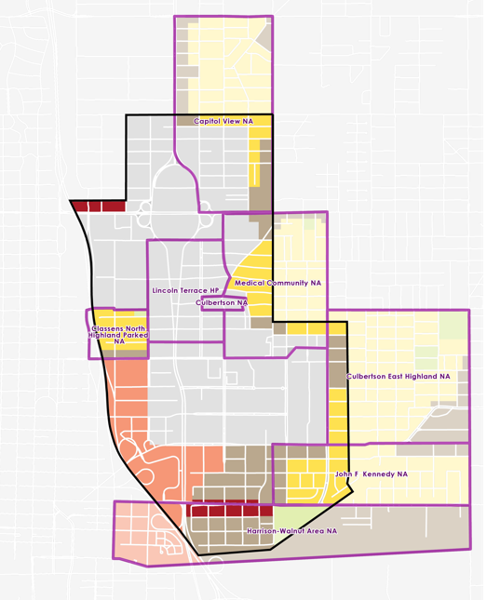
Why does the plan cut off my neighborhood?
Response:
◦ Plan boundaries are designed to address the buffer between the neighborhoods and adjacent development, not the entire neighborhood itself.
◦ Neighborhoods extend – intact – beyond the Land Use Plan boundary.
Notes:
Why don’t the Land Use Plan boundaries match up with neighborhood boundaries? The scope of the project was about the Innovation District, not neighborhood planning. Some boundaries stretched into the neighborhoods to address the interface/buffer between the neighborhoods and adjacent development.

Slide 15
How can residents have a voice in what happens in their neighborhood?
Response:
Maintain existing process for public hearings and property owner notification
Submit application
Staff review
Planning Commission
City Council
Building permit
Rezoning applications
Staff analyzes the proposal’s conformance with the comprehensive plan (including any amendments such as the Innovation District Land Use Plan) and provides a recommendation to Planning Commission
Holds public hearing(s) and makes a recommendation to City Council
Notices mailed to adjacent and nearby property owners
Holds public hearing(s) and makes the final decision on rezoning applications
Notes:
As mentioned previously, the land use plan will help buffers neighborhoods from traffic and noise by locating busier uses closer to I-235 and Lincoln Blvd, and by planning quieter buildings (medium-density) next to neighborhoods
The land use plan encourages protection and revitalization of existing parks, such as improvements and activities to Booker T. Washington Park)
Connects neighborhoods to services and employment by planning a network of safe and comfortable streets for all users, regardless of how they travel: cars, bike lanes, sidewalks, lighting, and public transit.
Proposed street types were developed from community engagement held by Perkins and Will and planokc recommendations (p. 36)

Slide 16
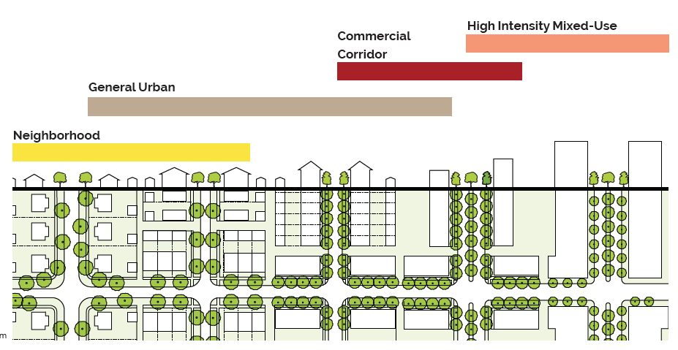
Land use plan: key features
• Guidelines for building form and density

Slide 17
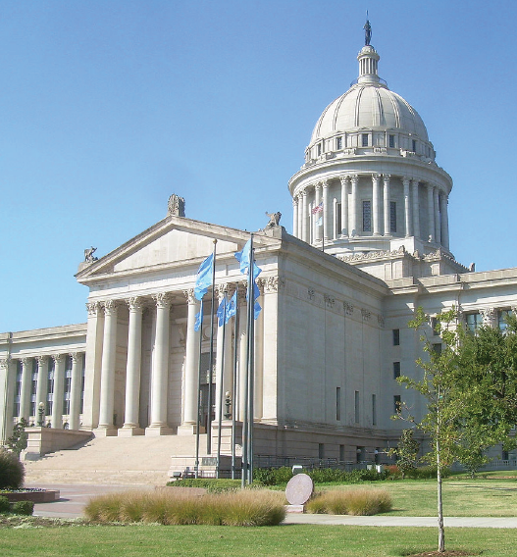
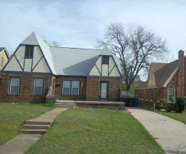
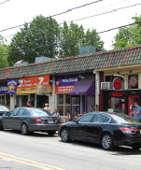

Slide 18
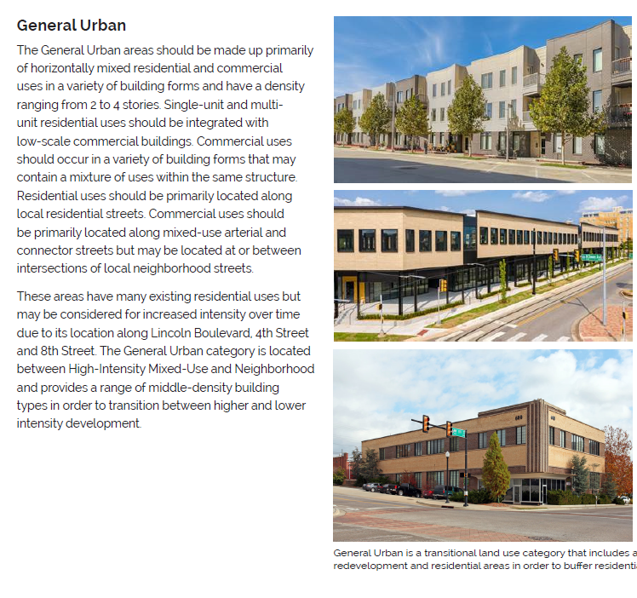
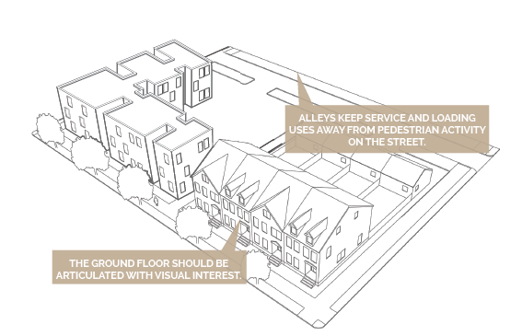
Land use plan: key features
• Guidelines for building heights, block sizes, lot widths, building setbacks, sidewalks, parking, and building design

Slide 19
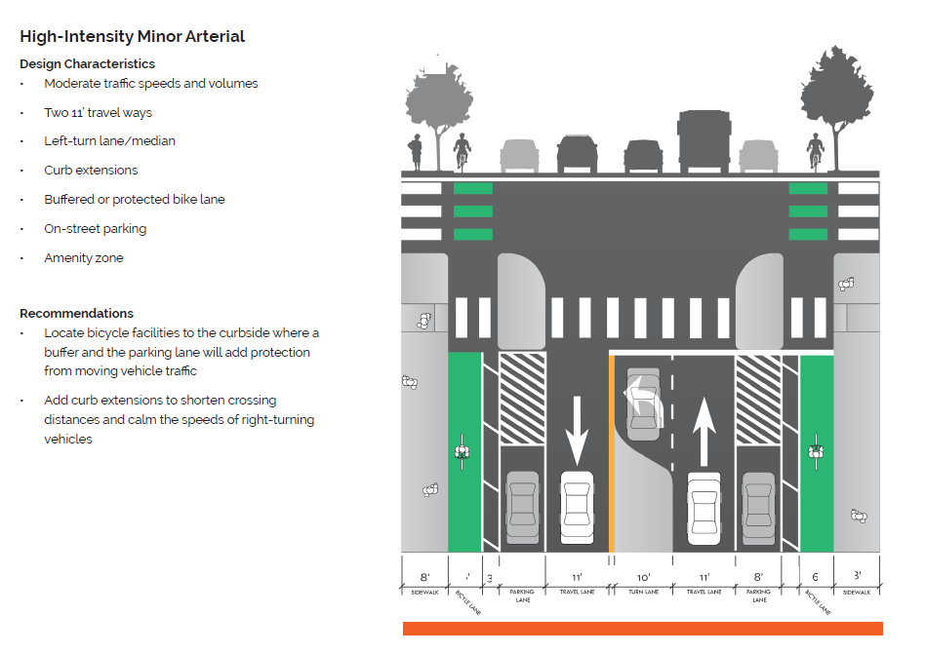
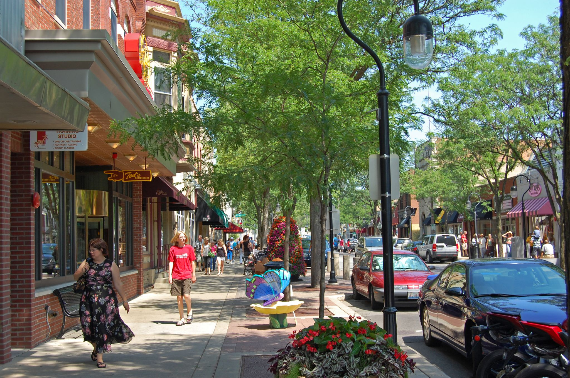
Land use plan: key features
• Guidelines for “livable streets”

Slide 20
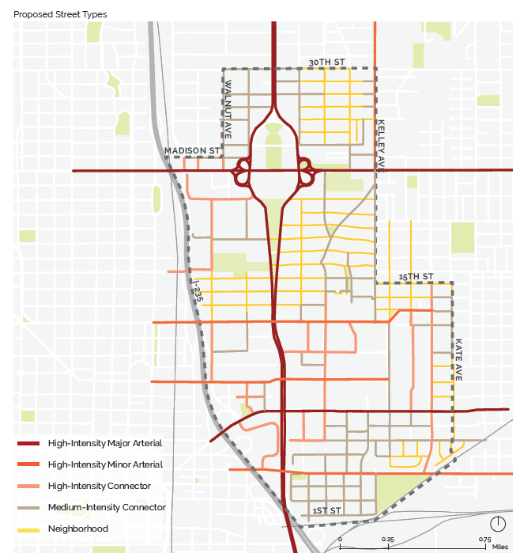
Land use plan: key features
• Connects neighborhoods and customers to services, businesses, and employment by planning for a network of safe and comfortable streets for all users

Slide 21
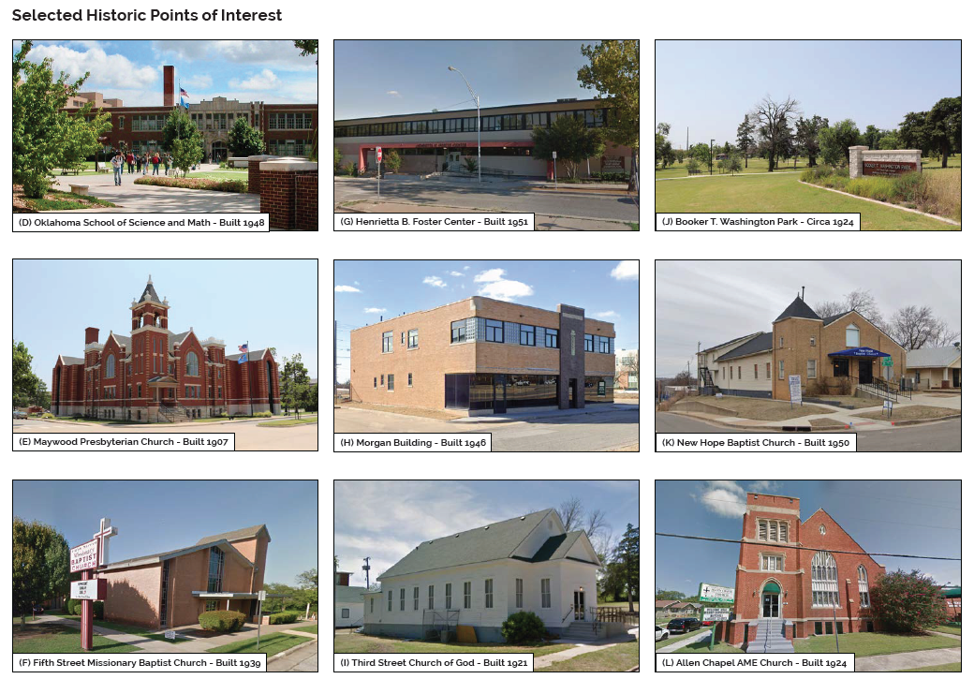
Land use plan: key features
• Guidelines for preserving historic buildings

Slide 22
next steps
Schedule
• Planning Commission 11-18-21
Action: adopt the Innovation District Land Use Plan as an amendment to the comprehensive plan
• City Council 12-21-21
Action: receive the amendment to the comprehensive plan
Questions?
Oklahoma City Planning Department
Lisa Chronister, Assistant Planning Director
lisa.chronister@okc.gov
(405) 297-1628

