Slide 1


OKC Active Transportation Initiatives
May 17, 2016

Slide 2
AGENDA
BikeWalkOKC
Process
Preliminary Results
Watch For Me OKC
Transportation Safety Campaign
Data Collection and Evaluation
Demonstration Corridors

Slide 3


Slide 4

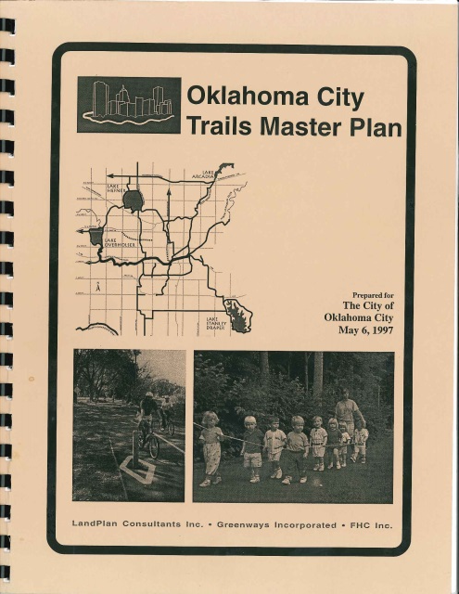
What is this project?
First ever bicycle and pedestrian master plan for Oklahoma City
An update to the 1997 Trails Master Plan
An update to the 2008 Bicycle Transportation Plan

Slide 5
GOALS FROM PLANOKC
  Transportation system is safe, convenient, and provides a variety of modes.
  The bicycle is used as a form of transportation.
  OKC has a complete network of sidewalks.

Slide 6
TIMELINE

Slide 7
STEERING COMMITTEE
ACOG
ODOT
Neighborhood Alliance
Oklahoma Bicycle Society
YMCA
COTPA
Public Works
Parks and Recreation
OCCHD
Community Foundation
The Alliance for Economic Development
ADG Architects
Oklahoma City Community Foundation
Kidical Mass

Slide 8
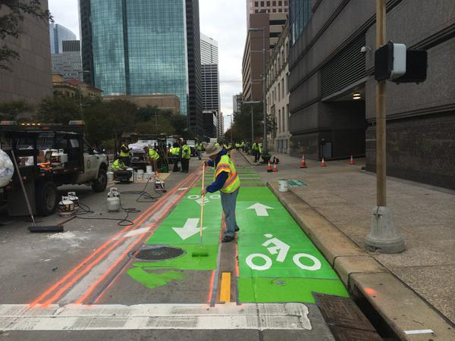
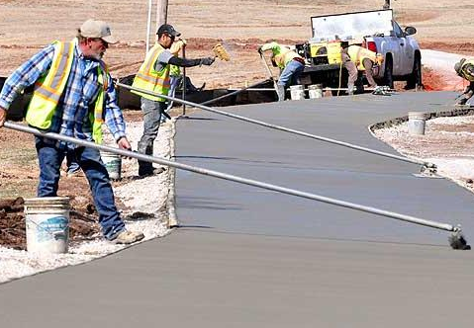
PLAN POLICIES
Incorporate proposed bicycle facilities on roadways being reconstructed, resurfaced, or restriped.

Slide 9
PLAN POLICIES
Work on education and encouragement programs with schools and other organizations.

Slide 10

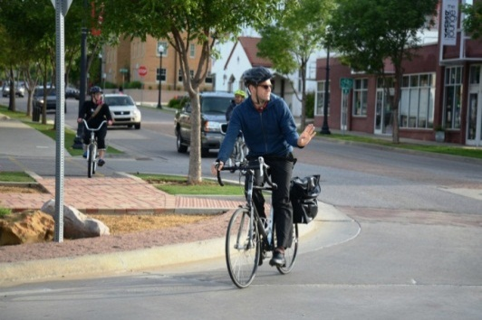
PLAN POLICIES
Encourage development of alternative transportation programs for employees.

Slide 11
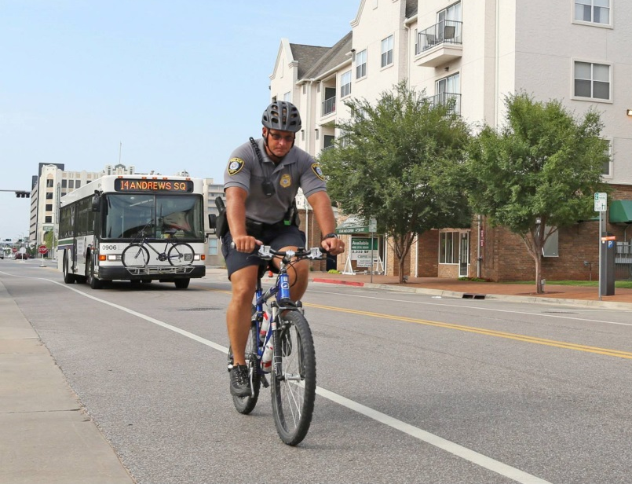
PLAN POLICIES
Improve and maintain enforcement, education, and bicycle safety programs.

Slide 12
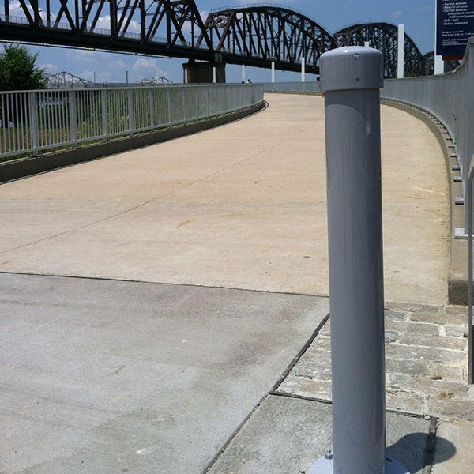
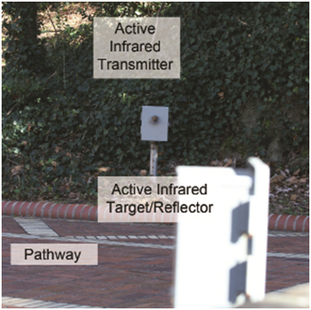
PLAN POLICIES
Set service goals and standards to improve the performance of facilities.

Slide 13
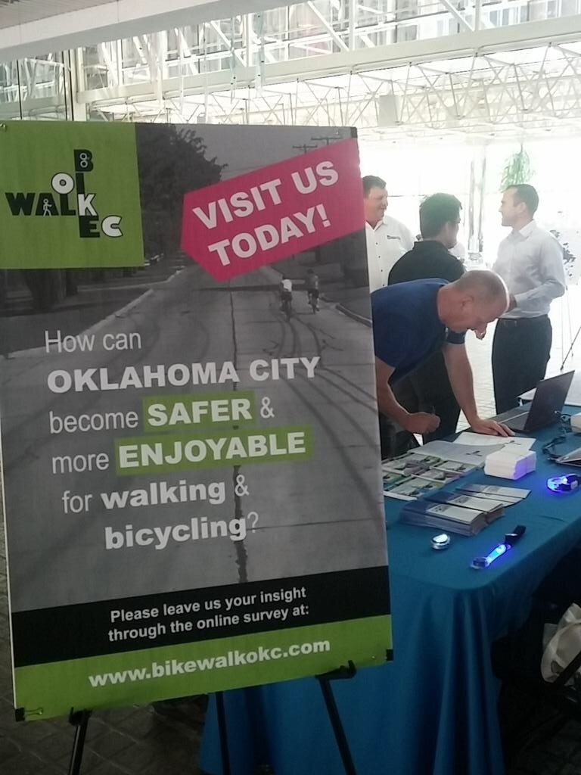
Outreach

Slide 14
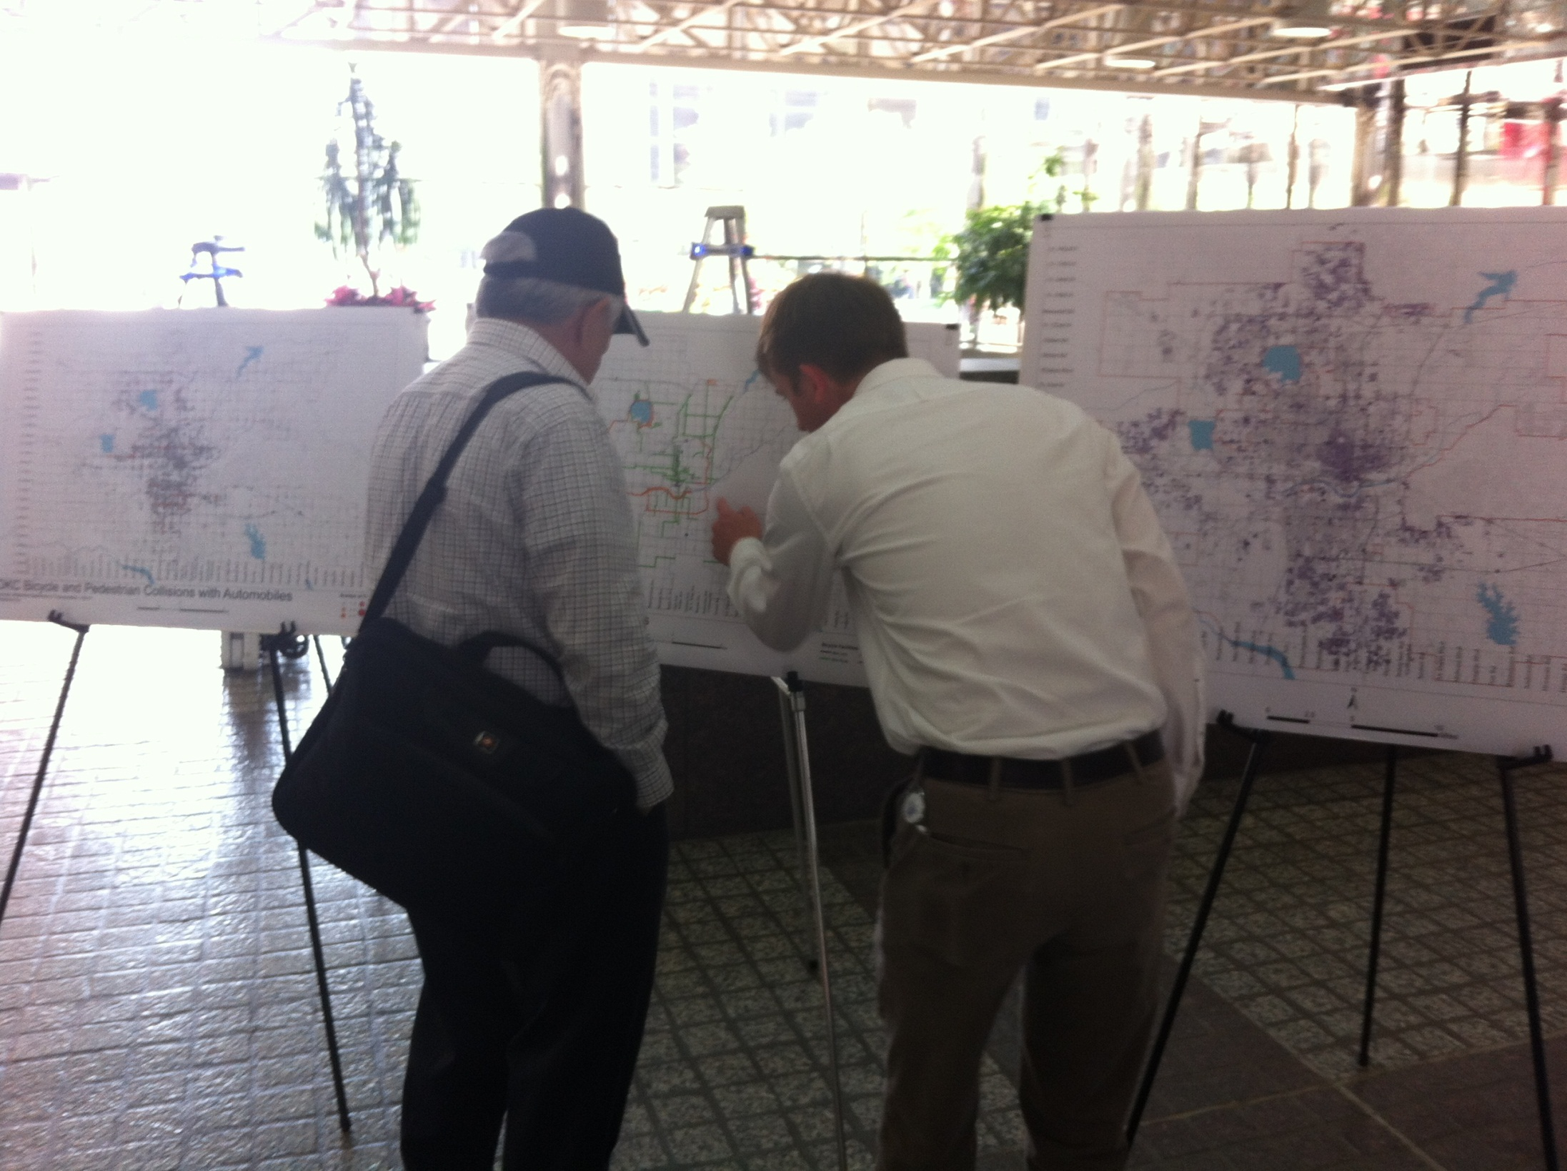

Slide 15
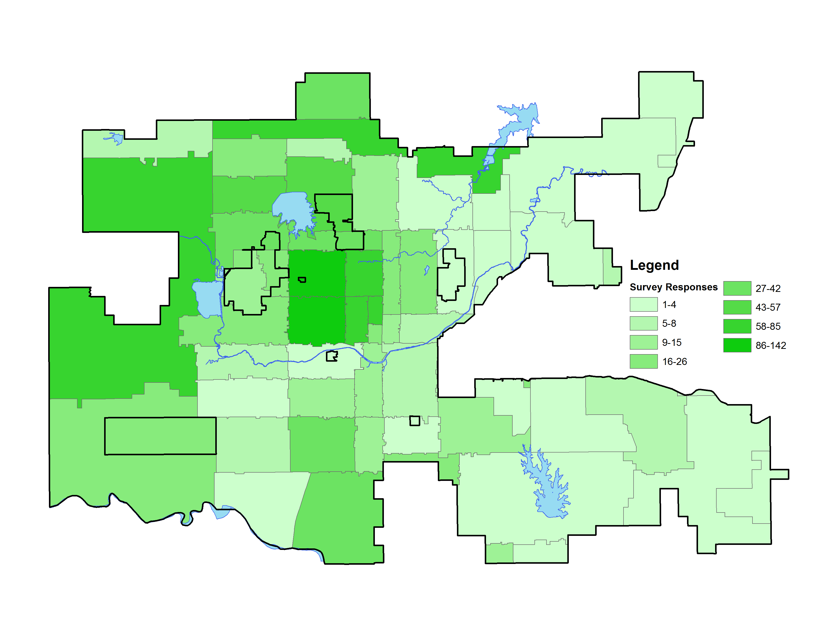
SURVEY RESPONDENTS

Slide 16
SURVEY RESULTS
  Less than 10% rate conditions as satisfactory
  More than 90% feel this is somewhat or very important
  Reasons for not walking or cycling:
    Lack of connectivity
    Traffic
    Unsafe crossing
    Aggressive motorists
    Unmaintained infrastructure

Slide 17
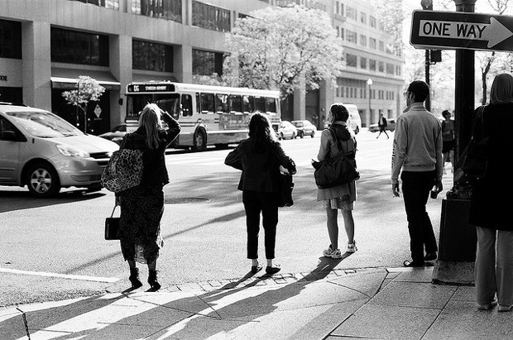
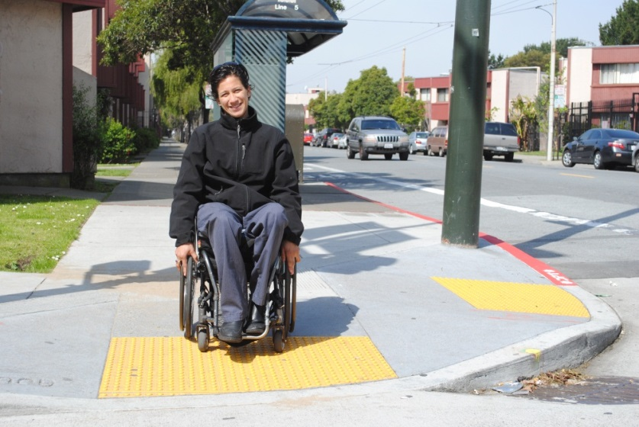
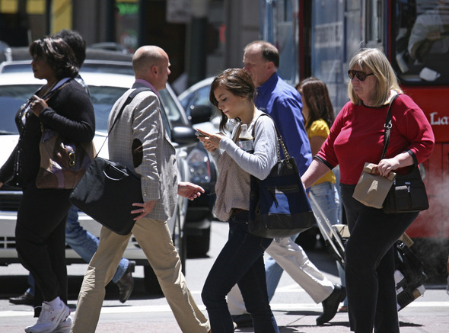
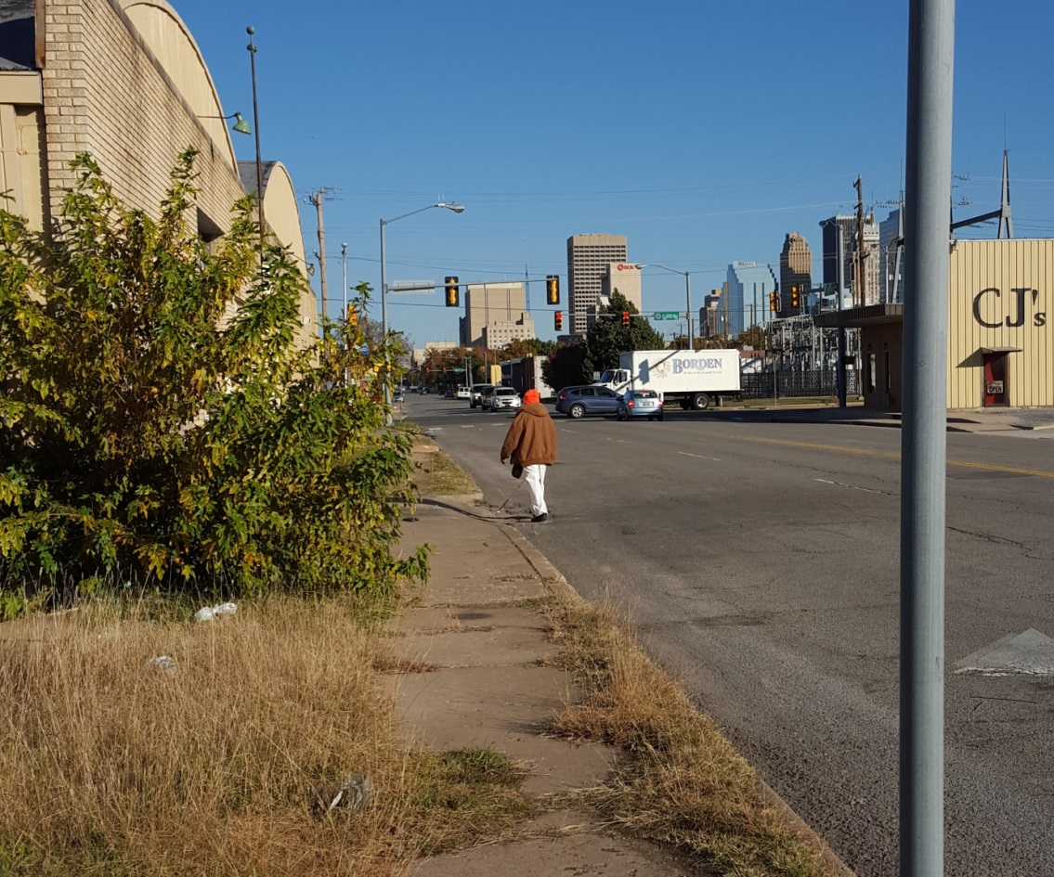

Slide 18
PEDESTRIAN ANALYSIS
DIGITAL
Large Scale
IN THE FIELD
Small Scale

Slide 19
PRIORITIZING PEDESTRIAN PROJECTS
  Responsive Populations
  Connectivity to Schools and Parks
  Connectivity to Existing Networks
  Neighborhood Revitalization
  Urban Commercial Districts

Slide 20
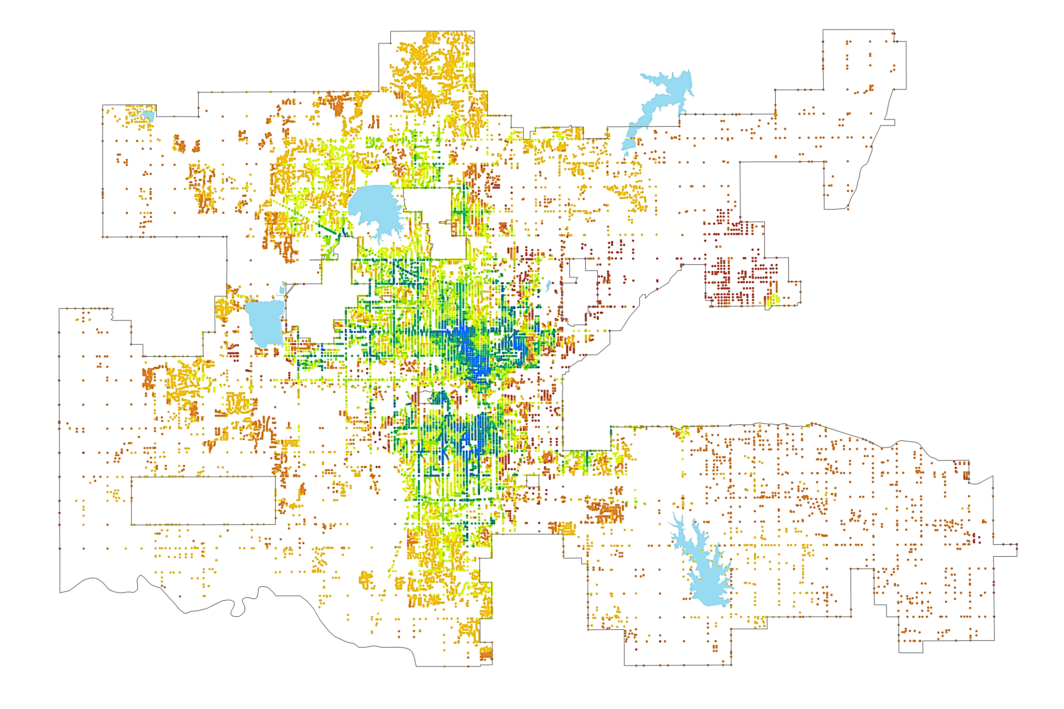

Digital Analysis to Identify Imminently Walkable Locations
Greatest Opportunity
Least Opportunity

Slide 21
PROJECT PRIORITIZATION
SIDEWALKS
  PHASE 1
    Prioritizing major roads
    Transit routes
    Access to pedestrian-generating land uses
  PHASE 2
    Connect neighborhoods to phase 1 sidewalks
    Closing gaps between streets with sidewalks
  PHASE 2

Slide 22


Slide 23

Phase 1

Slide 24

Phase 1
Phase 2

Slide 25
PROJECT PRIORITIZATION
INTERSECTIONS
  PHASE 1
    Improvements to underperforming existing facilities
    Improvements at phase 1 sidewalk intersections
  PHASE 2
    Improvements where phase 2 sidewalks meet phase 1 sidewalks
    Improvements at phase 2 sidewalk intersections

Slide 26
Phase 1
Phase 2

Slide 27

Phase 1
Phase 1
Phase 2
Phase 2

Slide 28
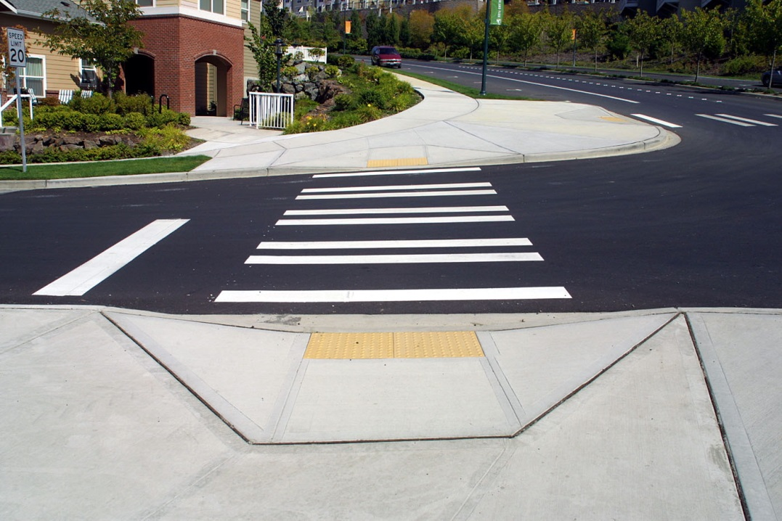
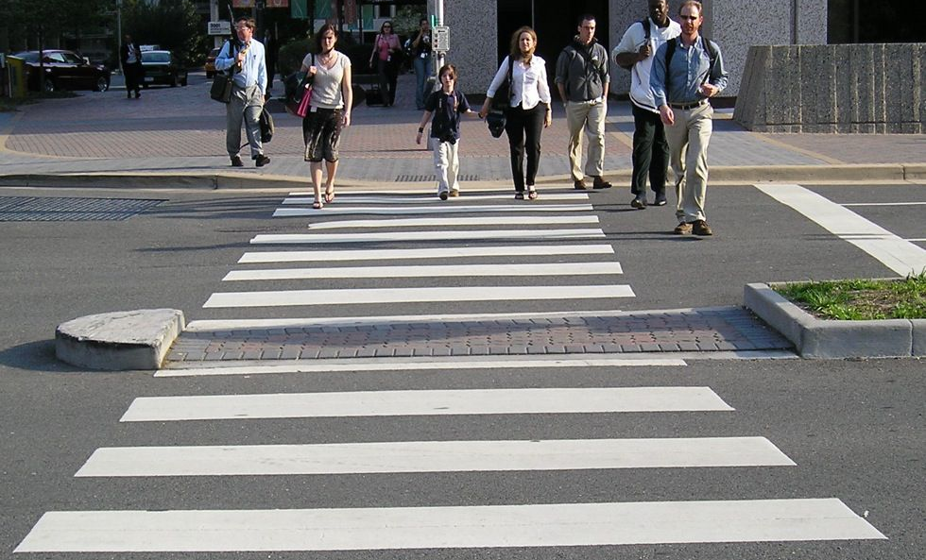
EXAMPLE INTERSECTION IMPROVEMENTS

Slide 29
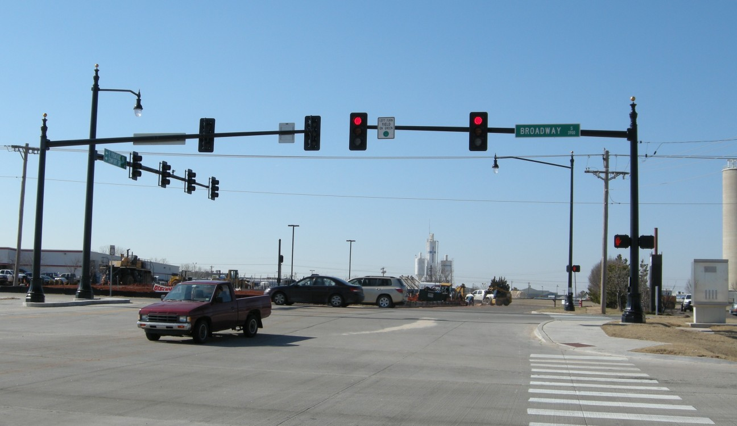
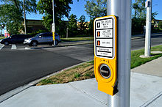

Slide 30
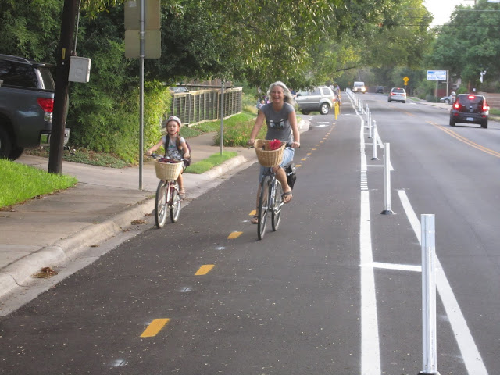
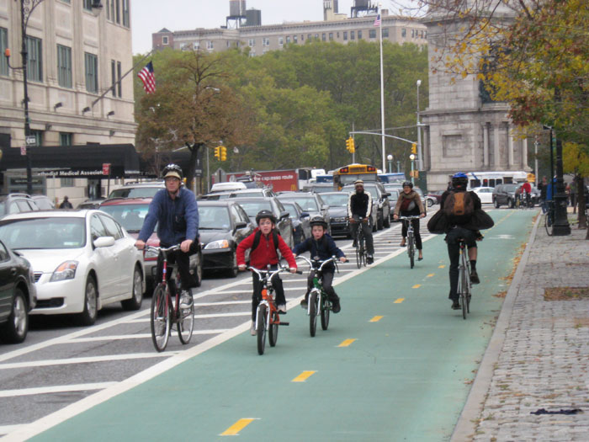
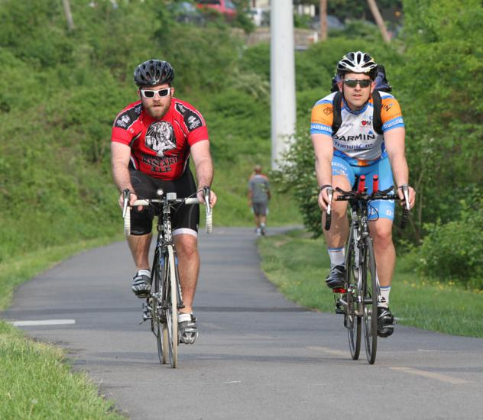
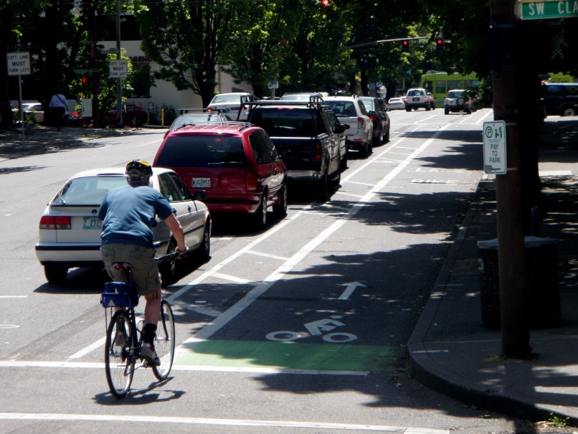
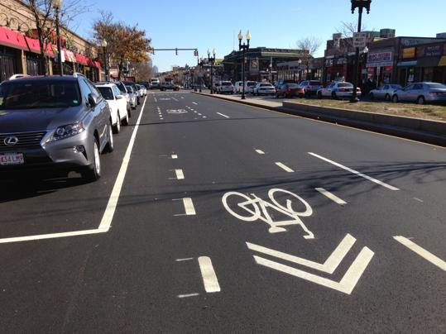

Slide 31
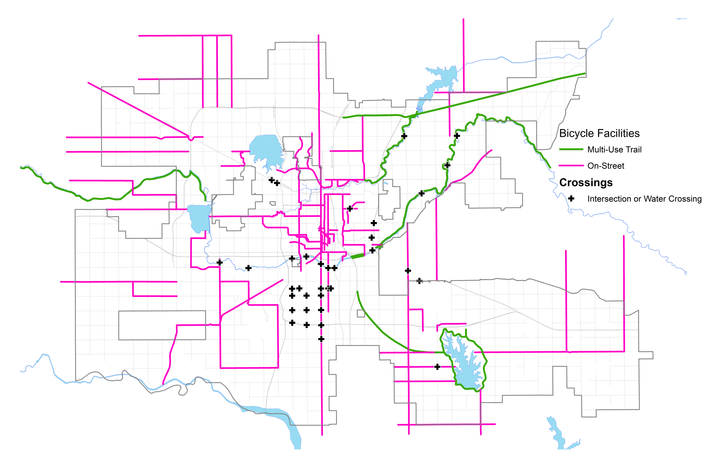
STEERING COMMITTEE MAP ACTIVITY

Slide 32
PROJECT IDENTIFICATION
  BICYCLE AND TRAIL PRIORITIES
    Connect existing resources
    Cross barriers
    Mix of transportation and recreational facilities (and dual purpose)

Slide 33
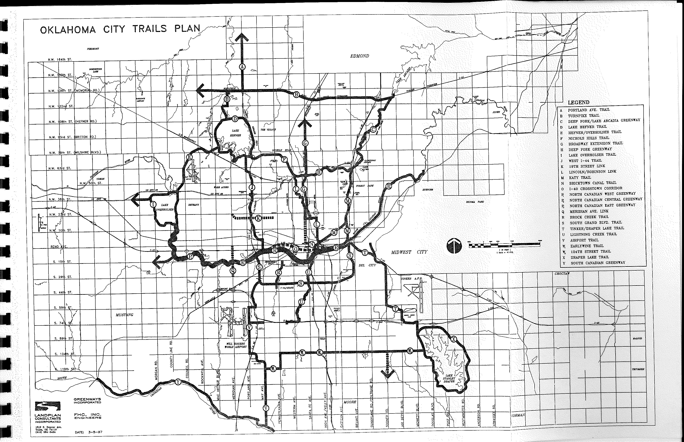
1997 TRAILS MASTER PLAN
Add
Subtract
Modify
Reroute
Reclassify

Slide 34
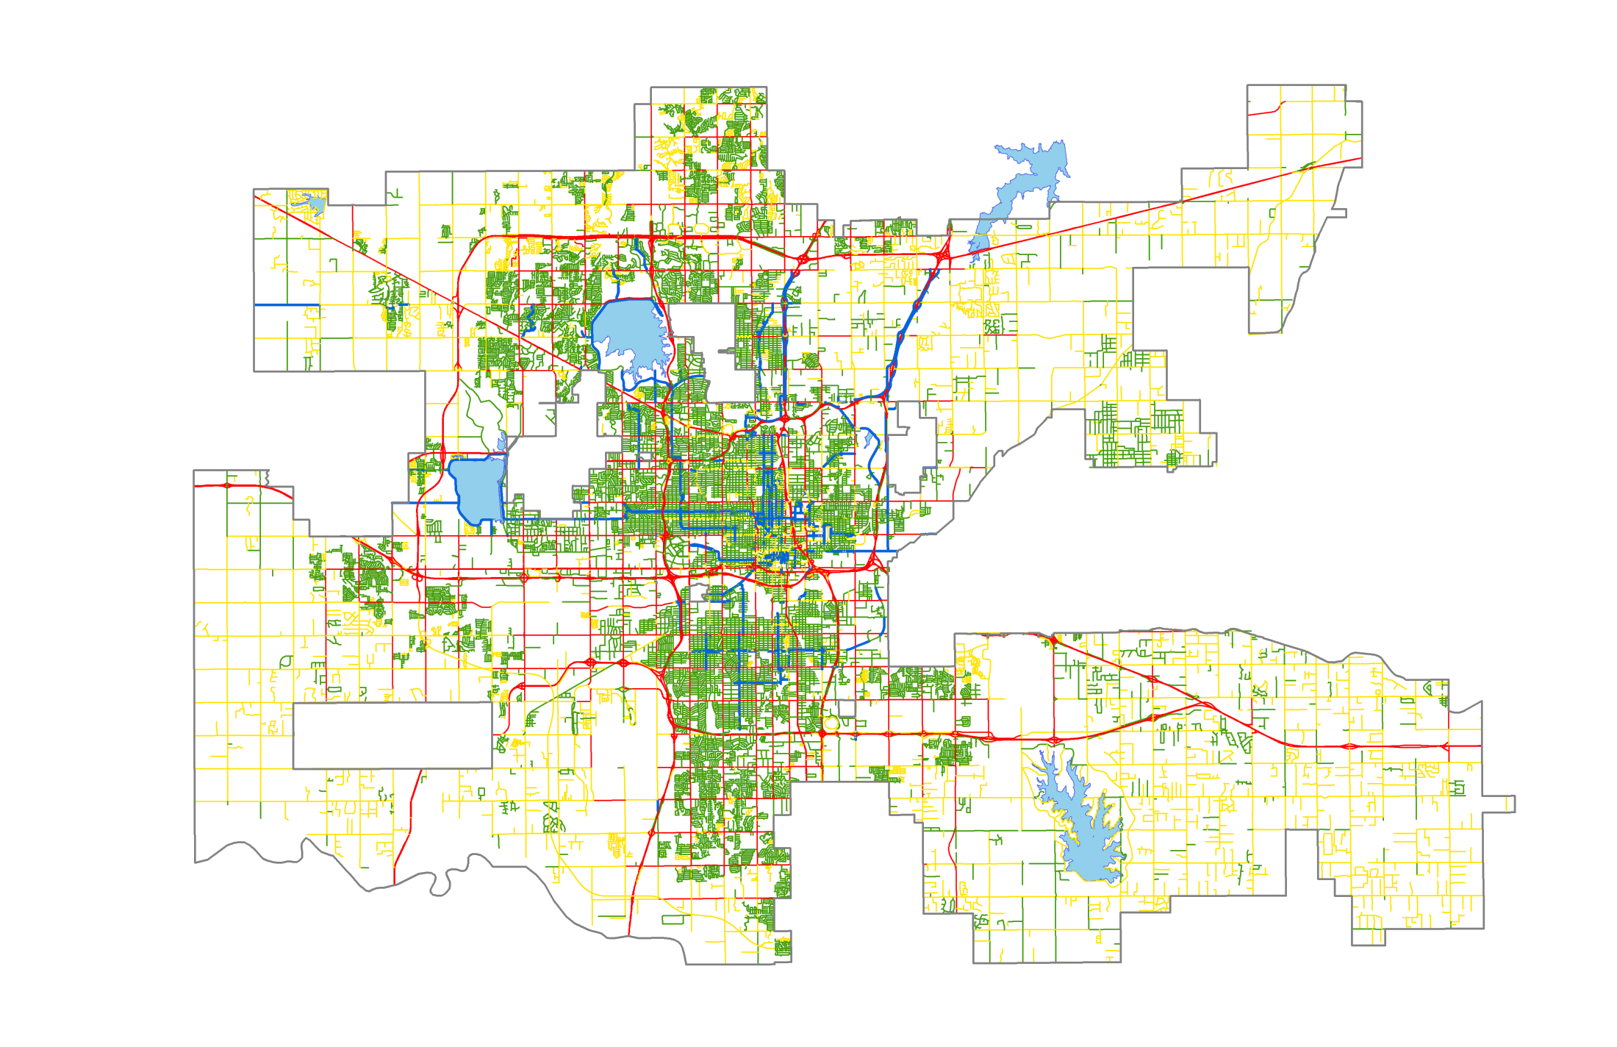
Bicycle Suitability Analysis – Existing Conditions
Highest Suitability
Lowest Suitability

Slide 35
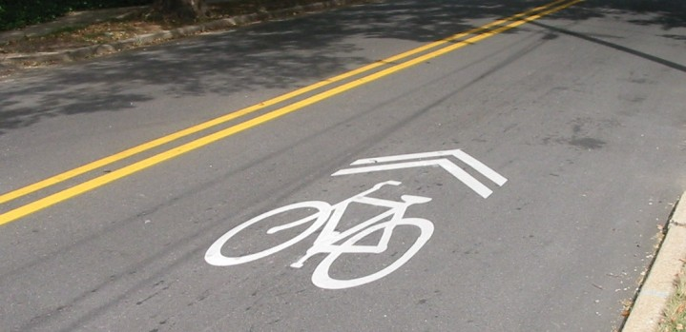
BICYCLE FACILITY TYPES
Bike Route
Share lane with auto
Urban - 25mph or less
Rural - shoulder preferred

Slide 36
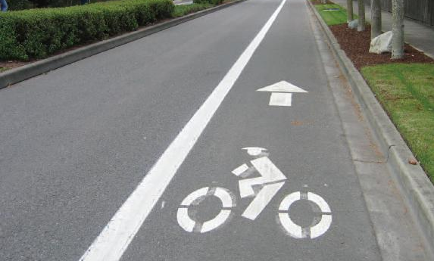
BICYCLE FACILITY TYPES
Bike Lane
Dedicated Space
4 - 8 ft wide
Currently have 7 miles

Slide 37
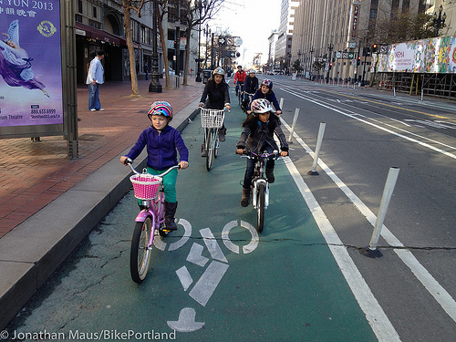
BICYCLE FACILITY TYPES
Protected Bike Lane
Dedicated Space
5-12ft wide

Slide 38
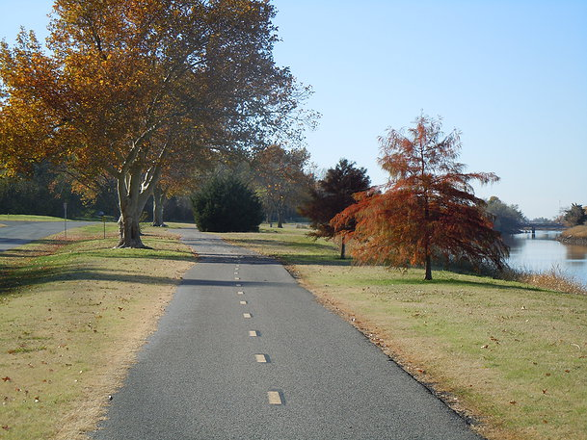
BICYCLE FACILITY TYPES
Multi-Use Trail
10-12ft wide
Completely separated from auto
Safest facility

Slide 39
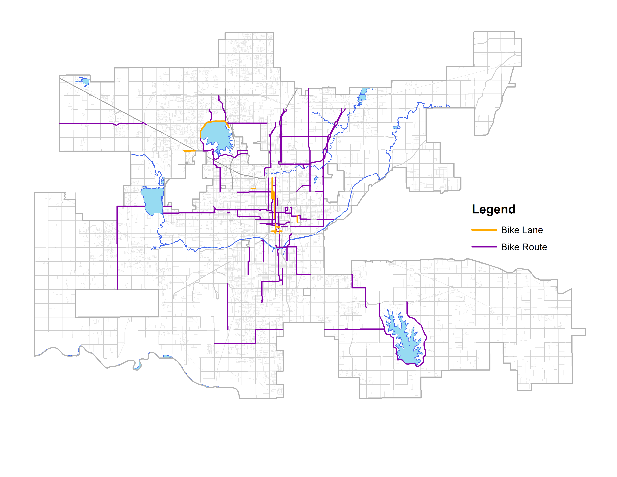
EXISTING ON-STREET BICYCLE NETWORK

Slide 40
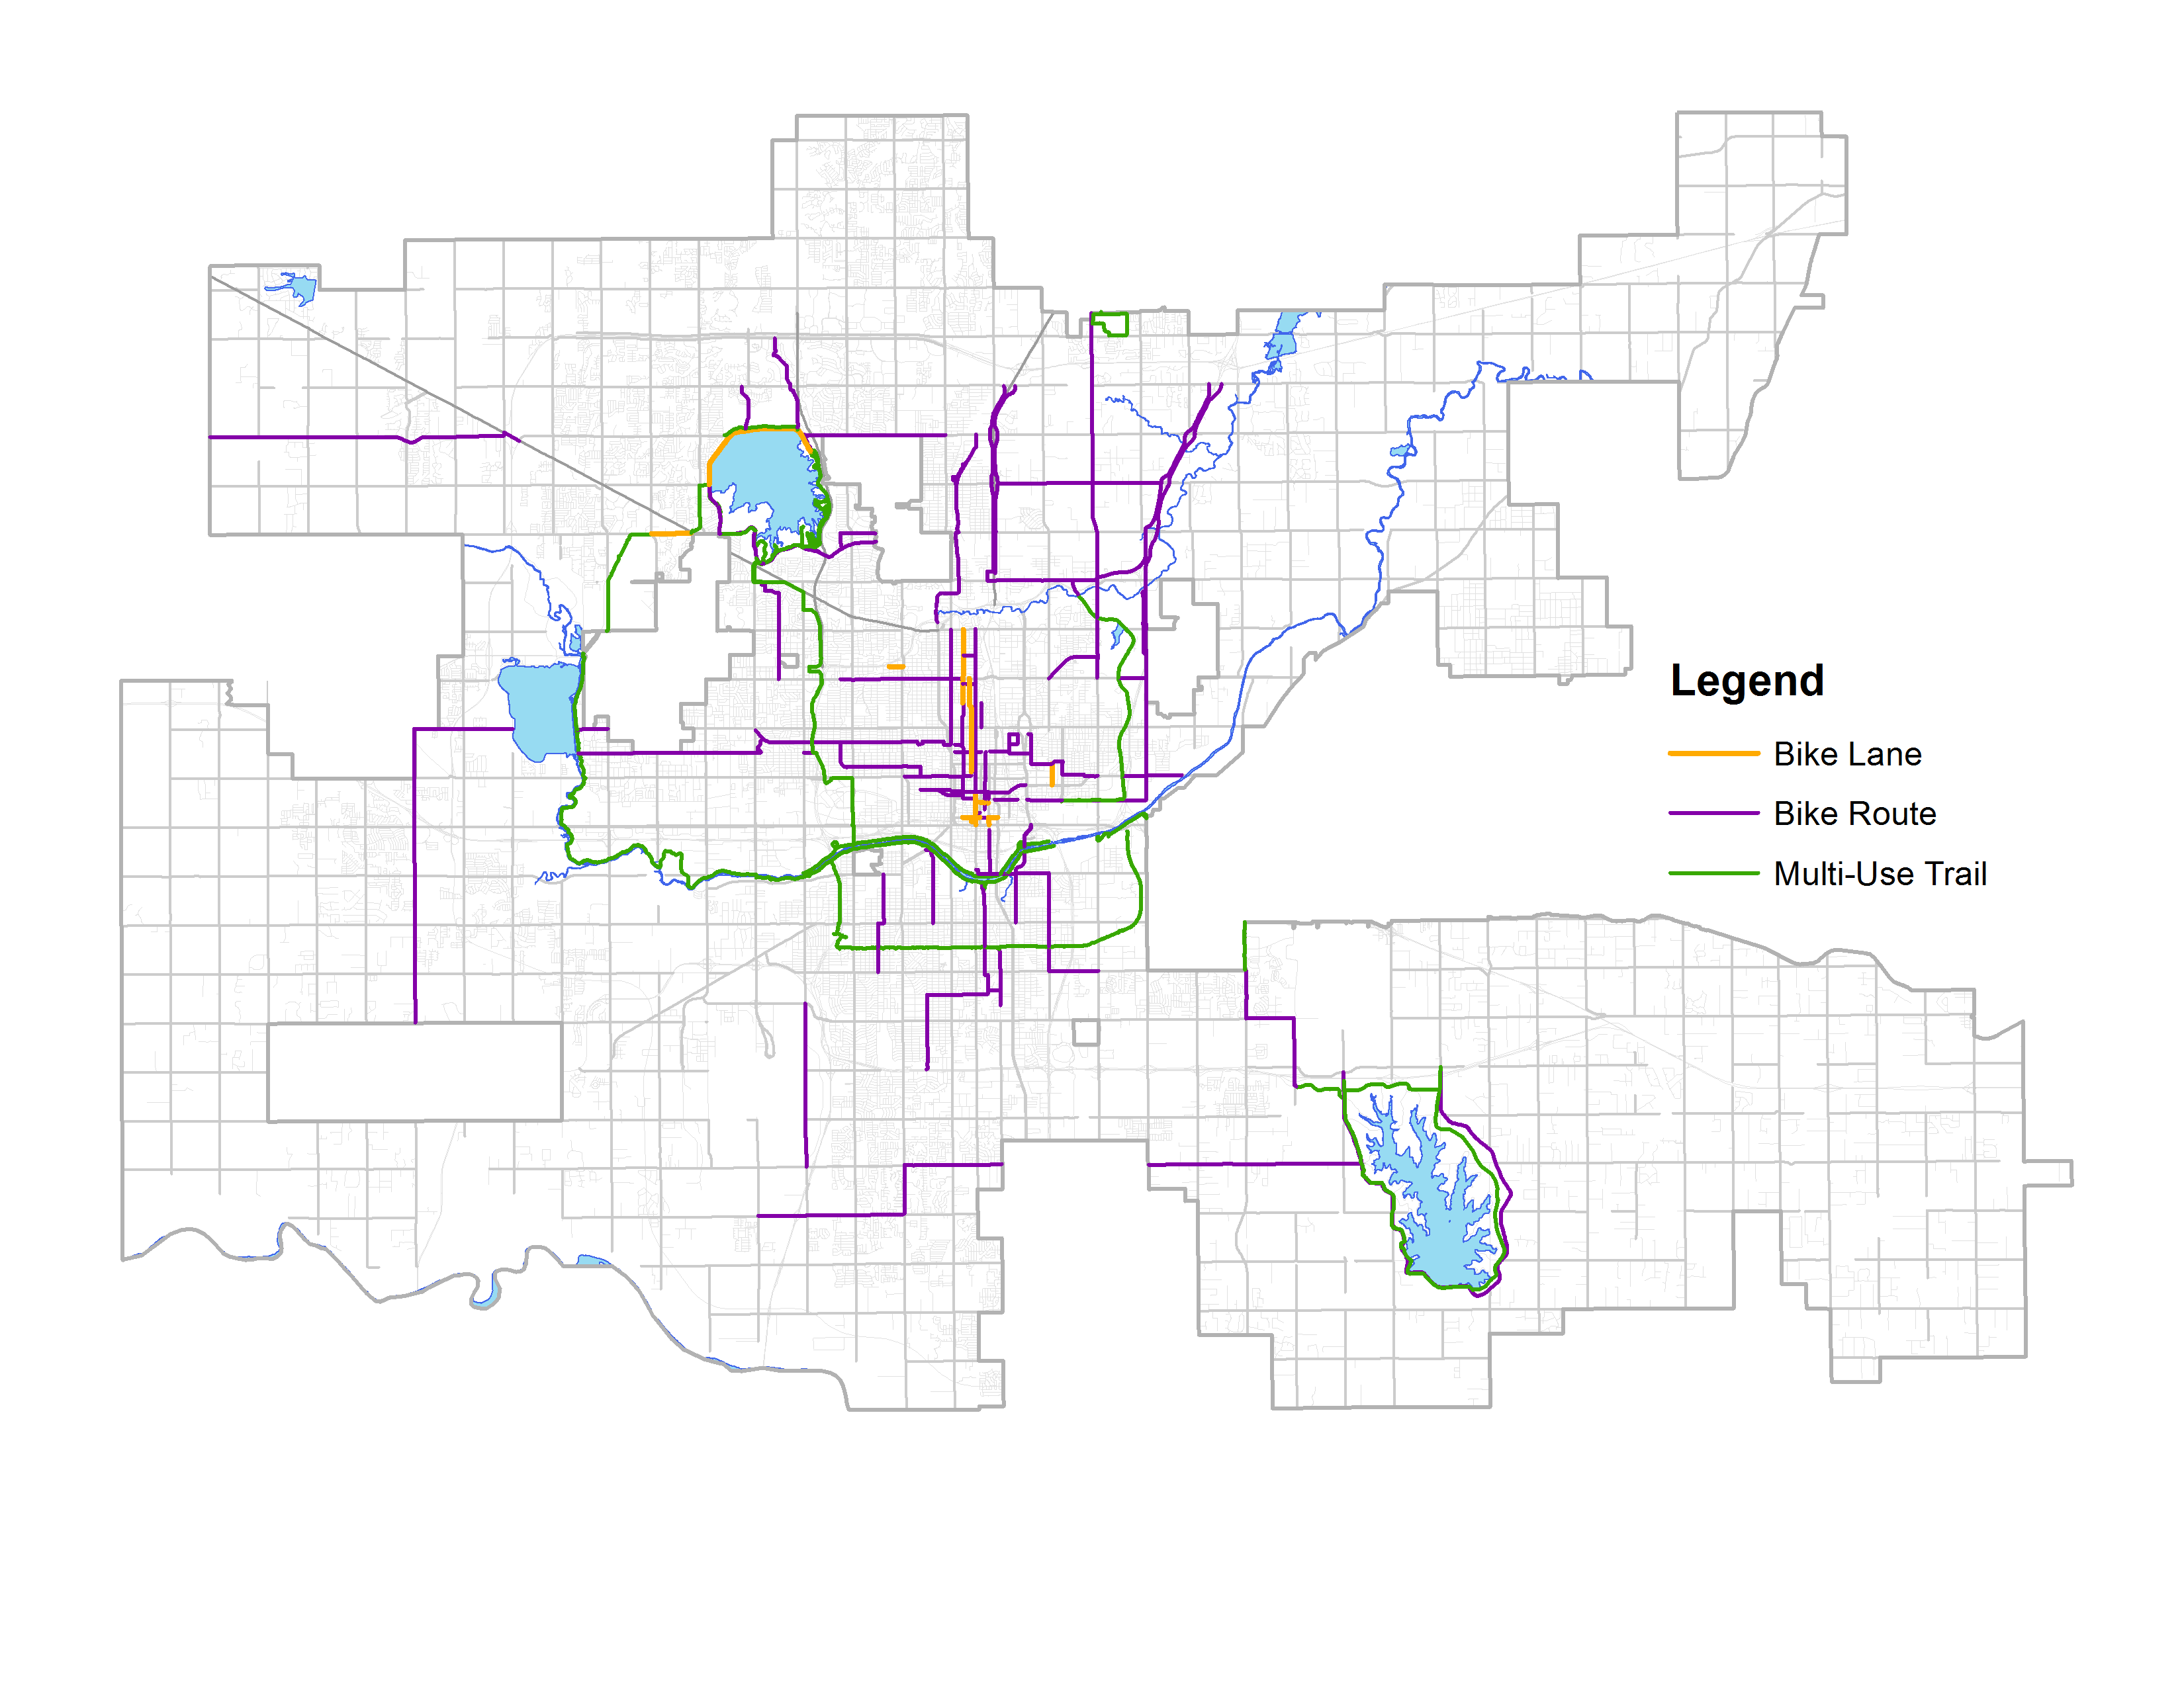
EXISTING BICYCLE NETWORK

Slide 41
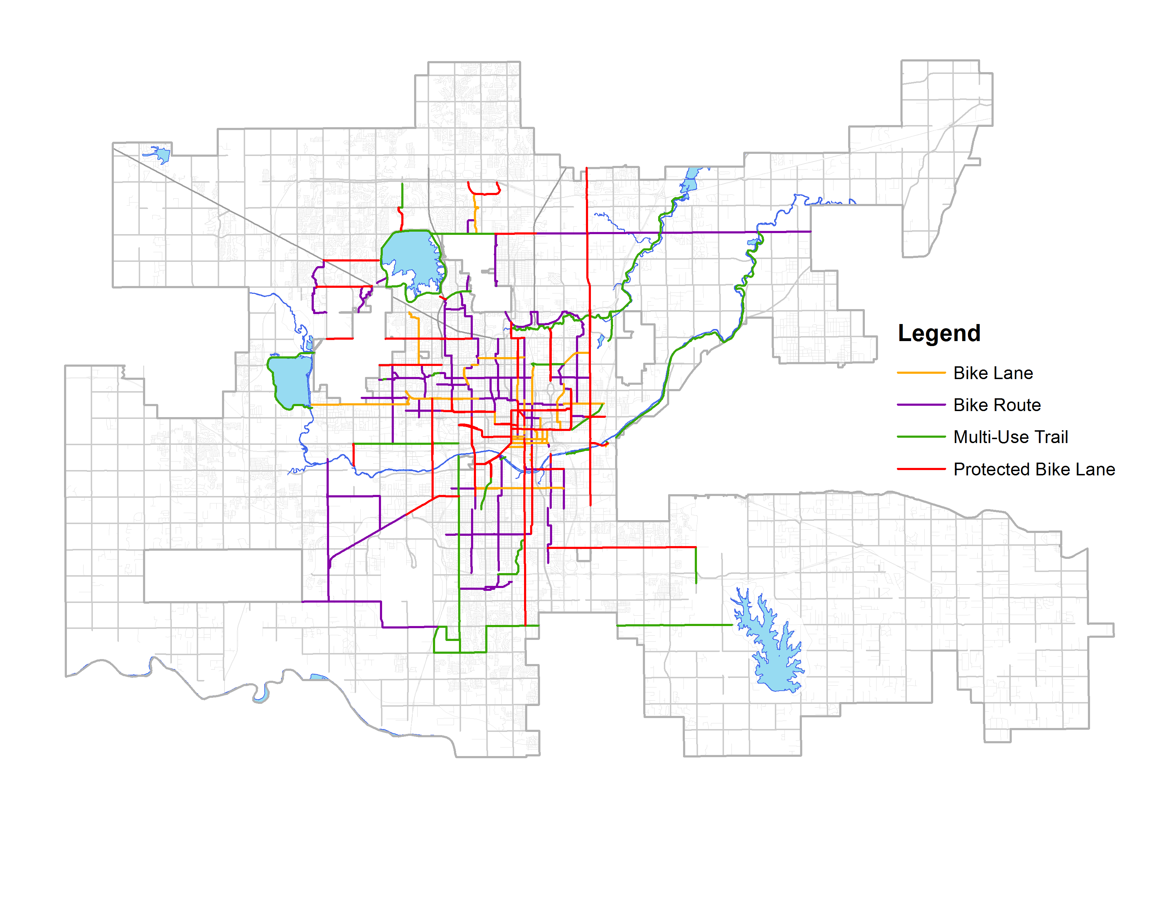
NEW BICYCLE FACILITIES

Slide 42
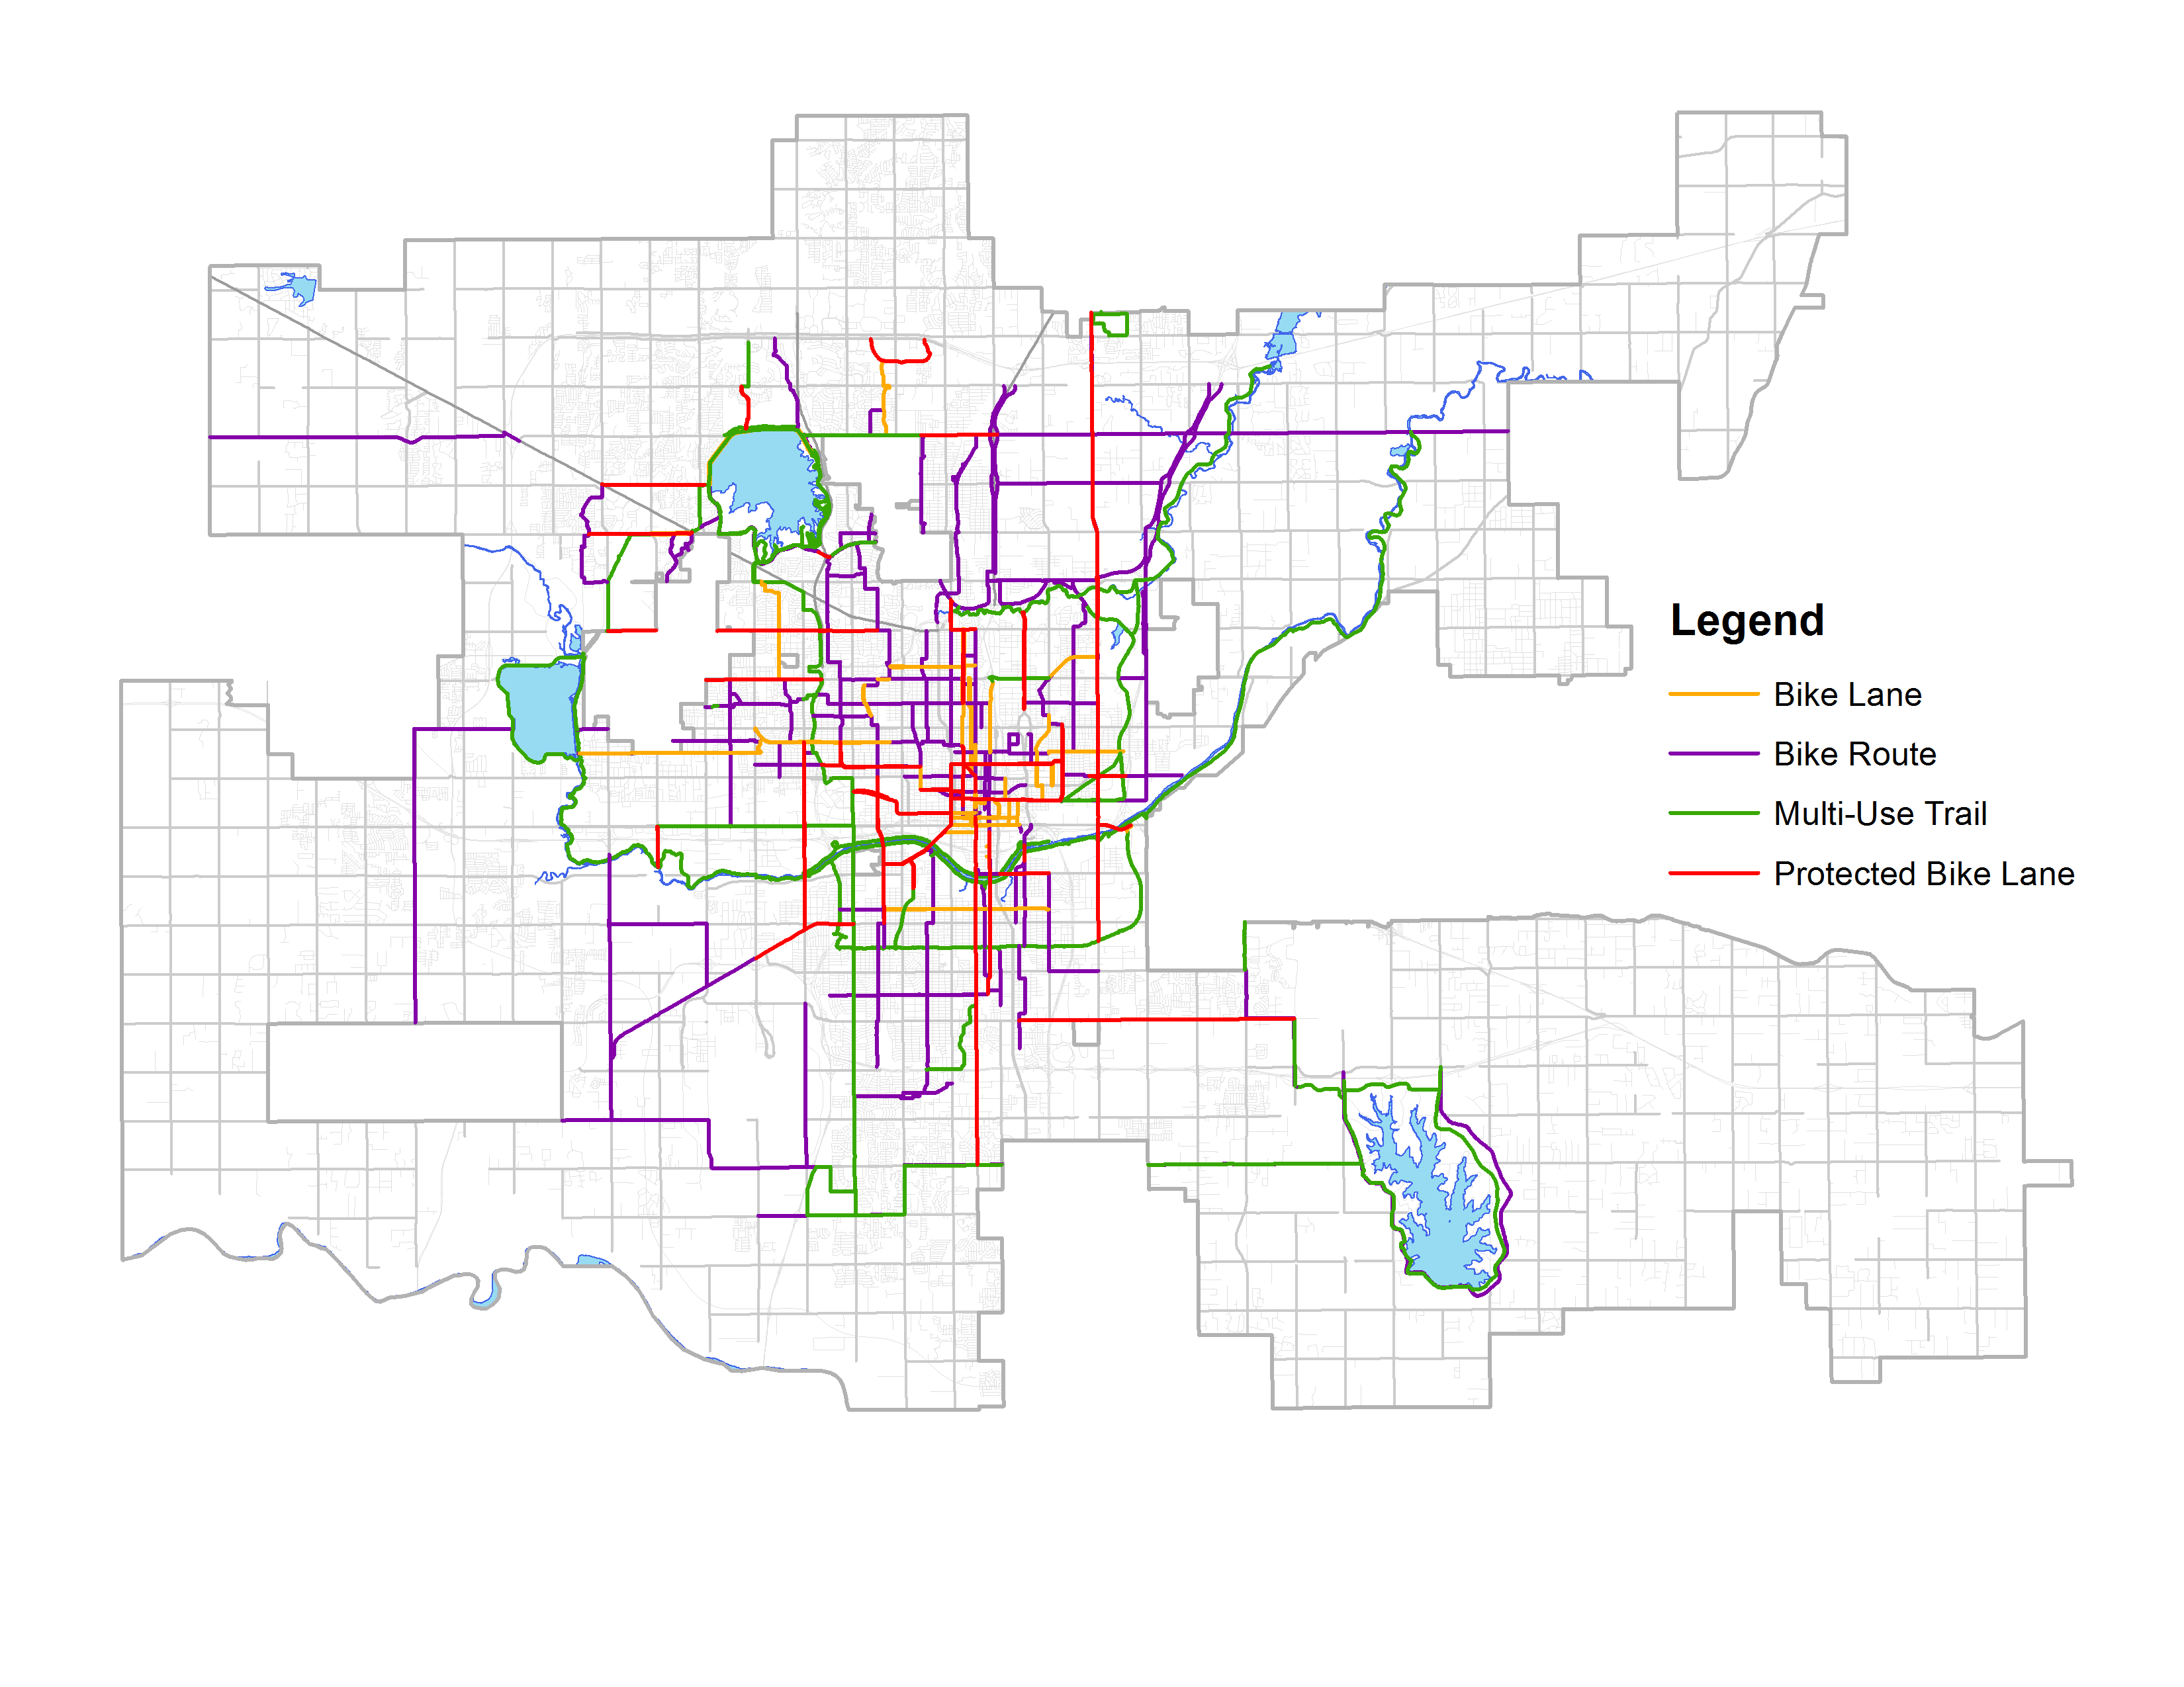
PROPOSED BICYCLE NETWORK

Slide 43
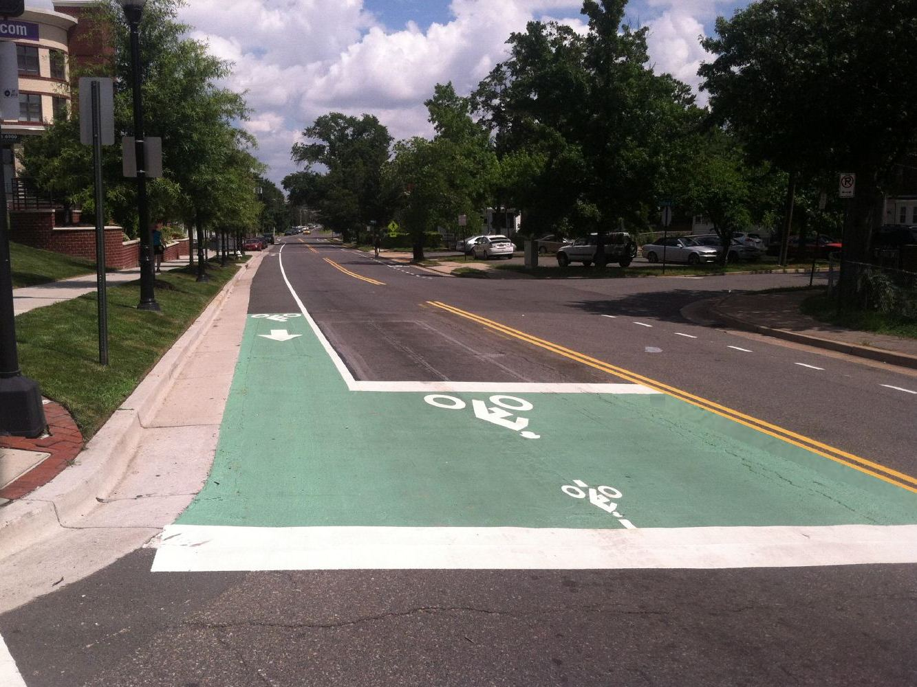
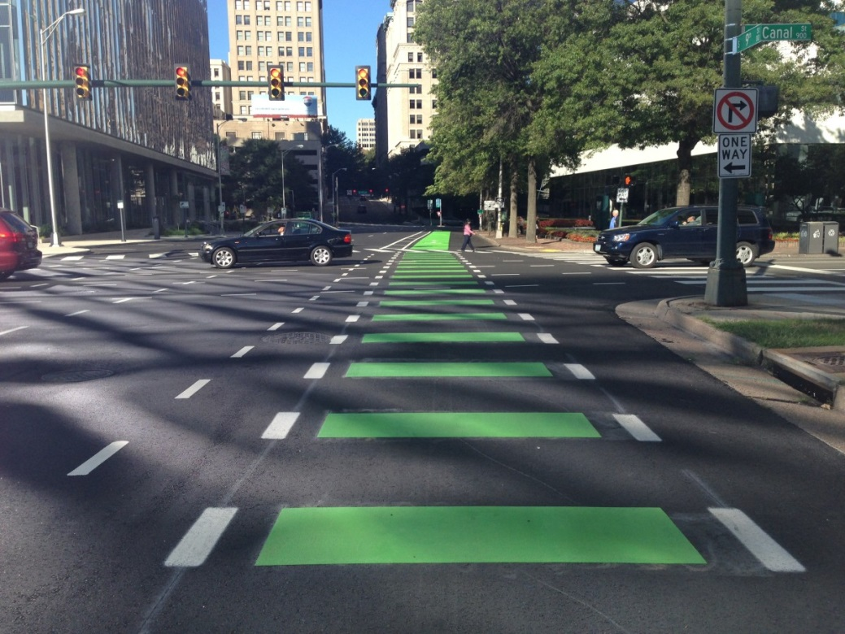
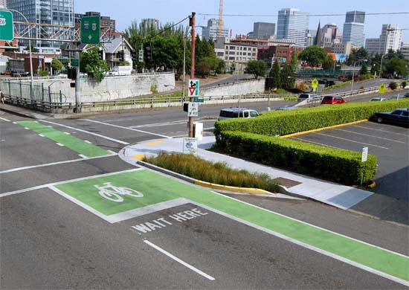
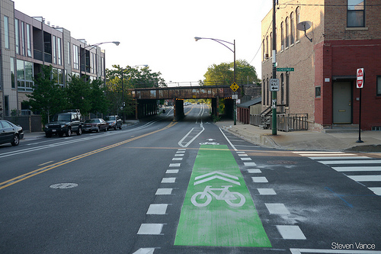
INTERSECTION IMPROVEMENT
EXAMPLES

Slide 44
AGENDA
BikeWalkOKC
Process
Preliminary Results
Watch For Me OKC
Transportation Safety Campaign
Data Collection and Evaluation
Demonstration Corridors

Slide 45

FHWA Safety Grant
Grant #1
  $404,700 Federal Share
Grant #2
  $357,000 Federal Share

Slide 46
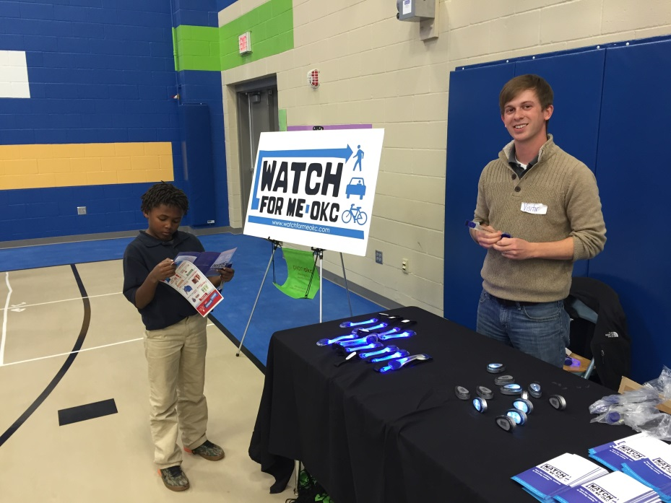
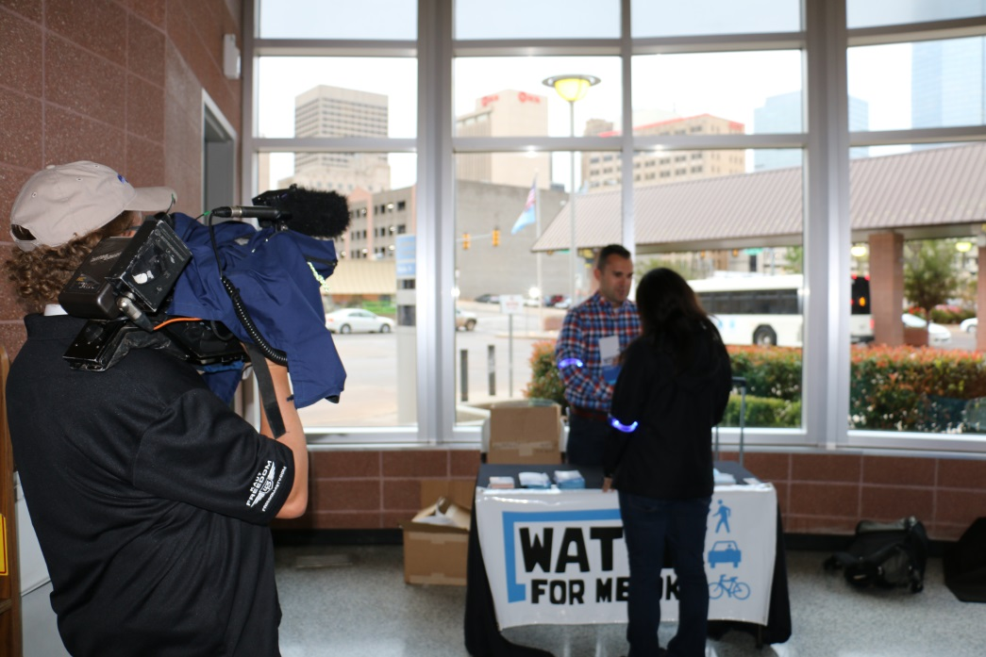
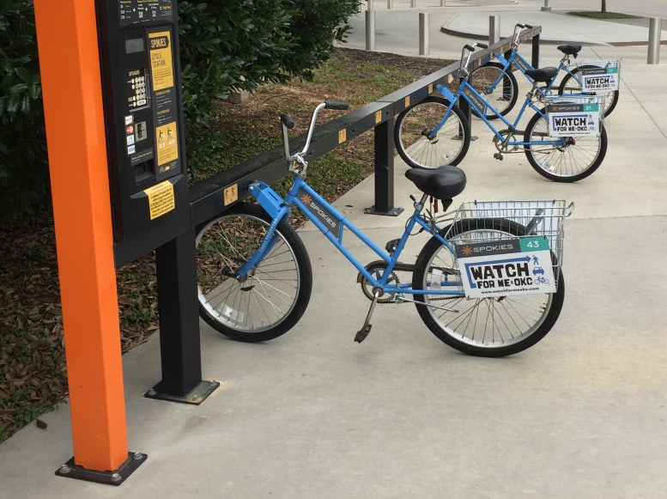
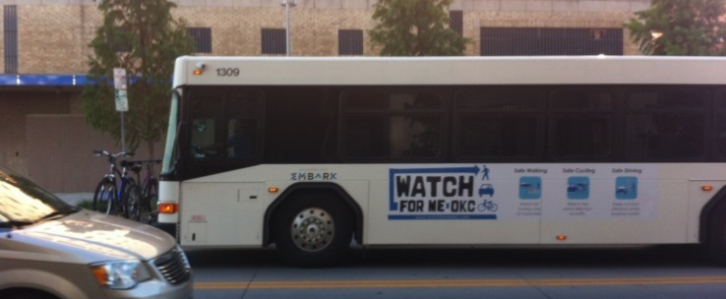
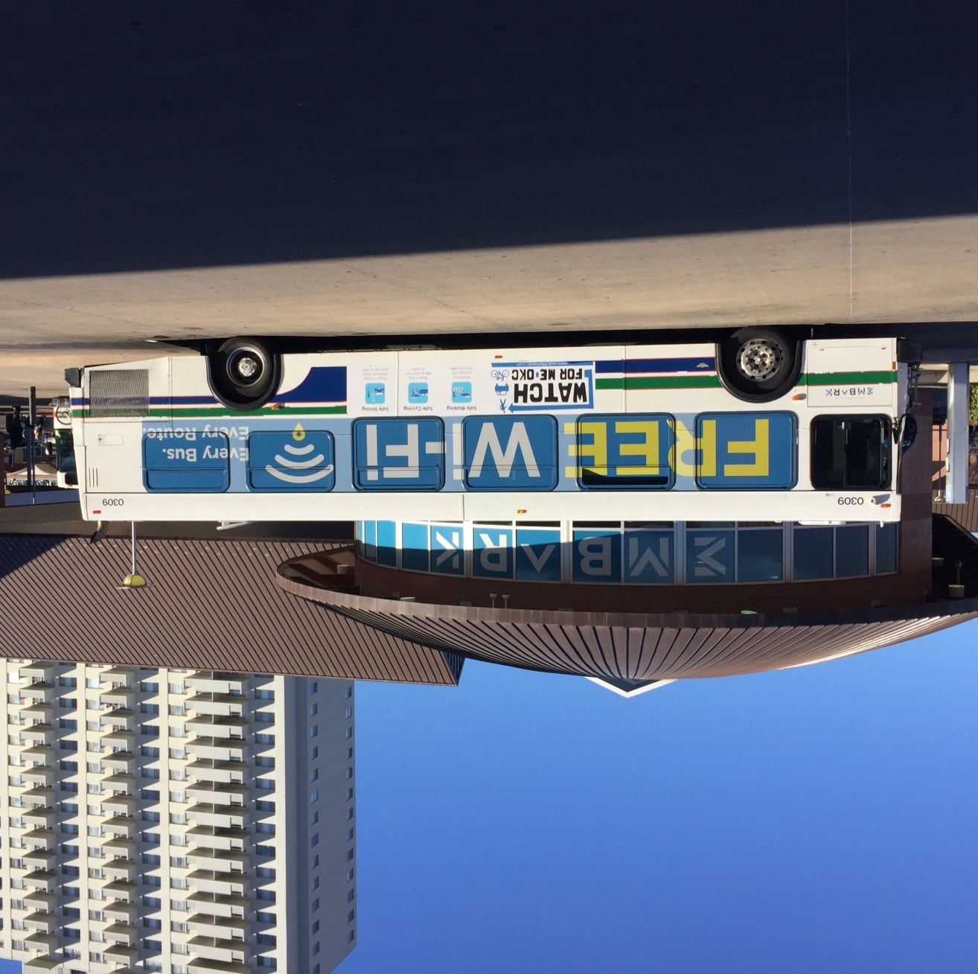

Slide 47

PROMOTIONAL ITEMS

Slide 48
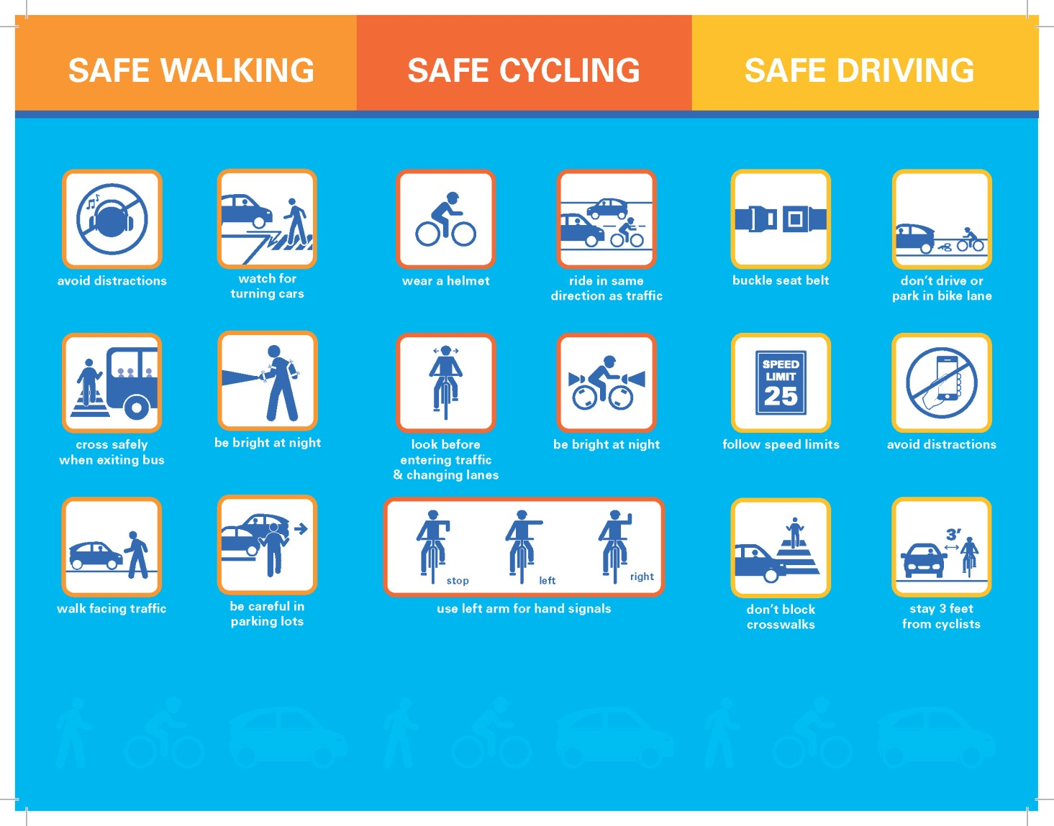
PROMOTIONAL ITEMS

Slide 49

Radio Campaign
PROMOTIONAL ITEMS

Slide 50
DATA COLLECTION AND EVALUATION
  Bicycle and Pedestrian Counters
    Katy Trail
    Lake Hefner Trail
    I-44 Trail

Slide 51
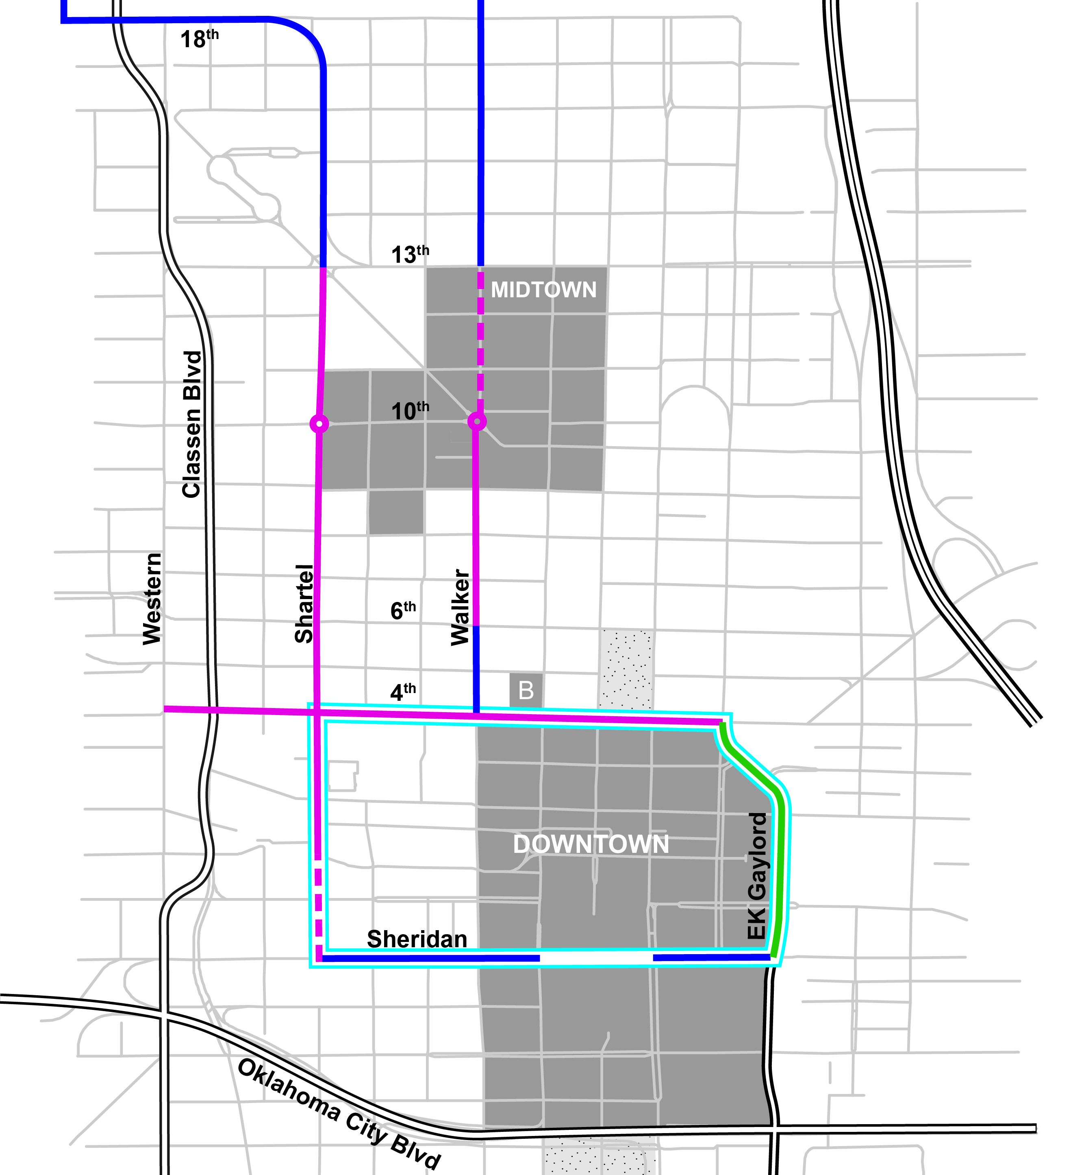
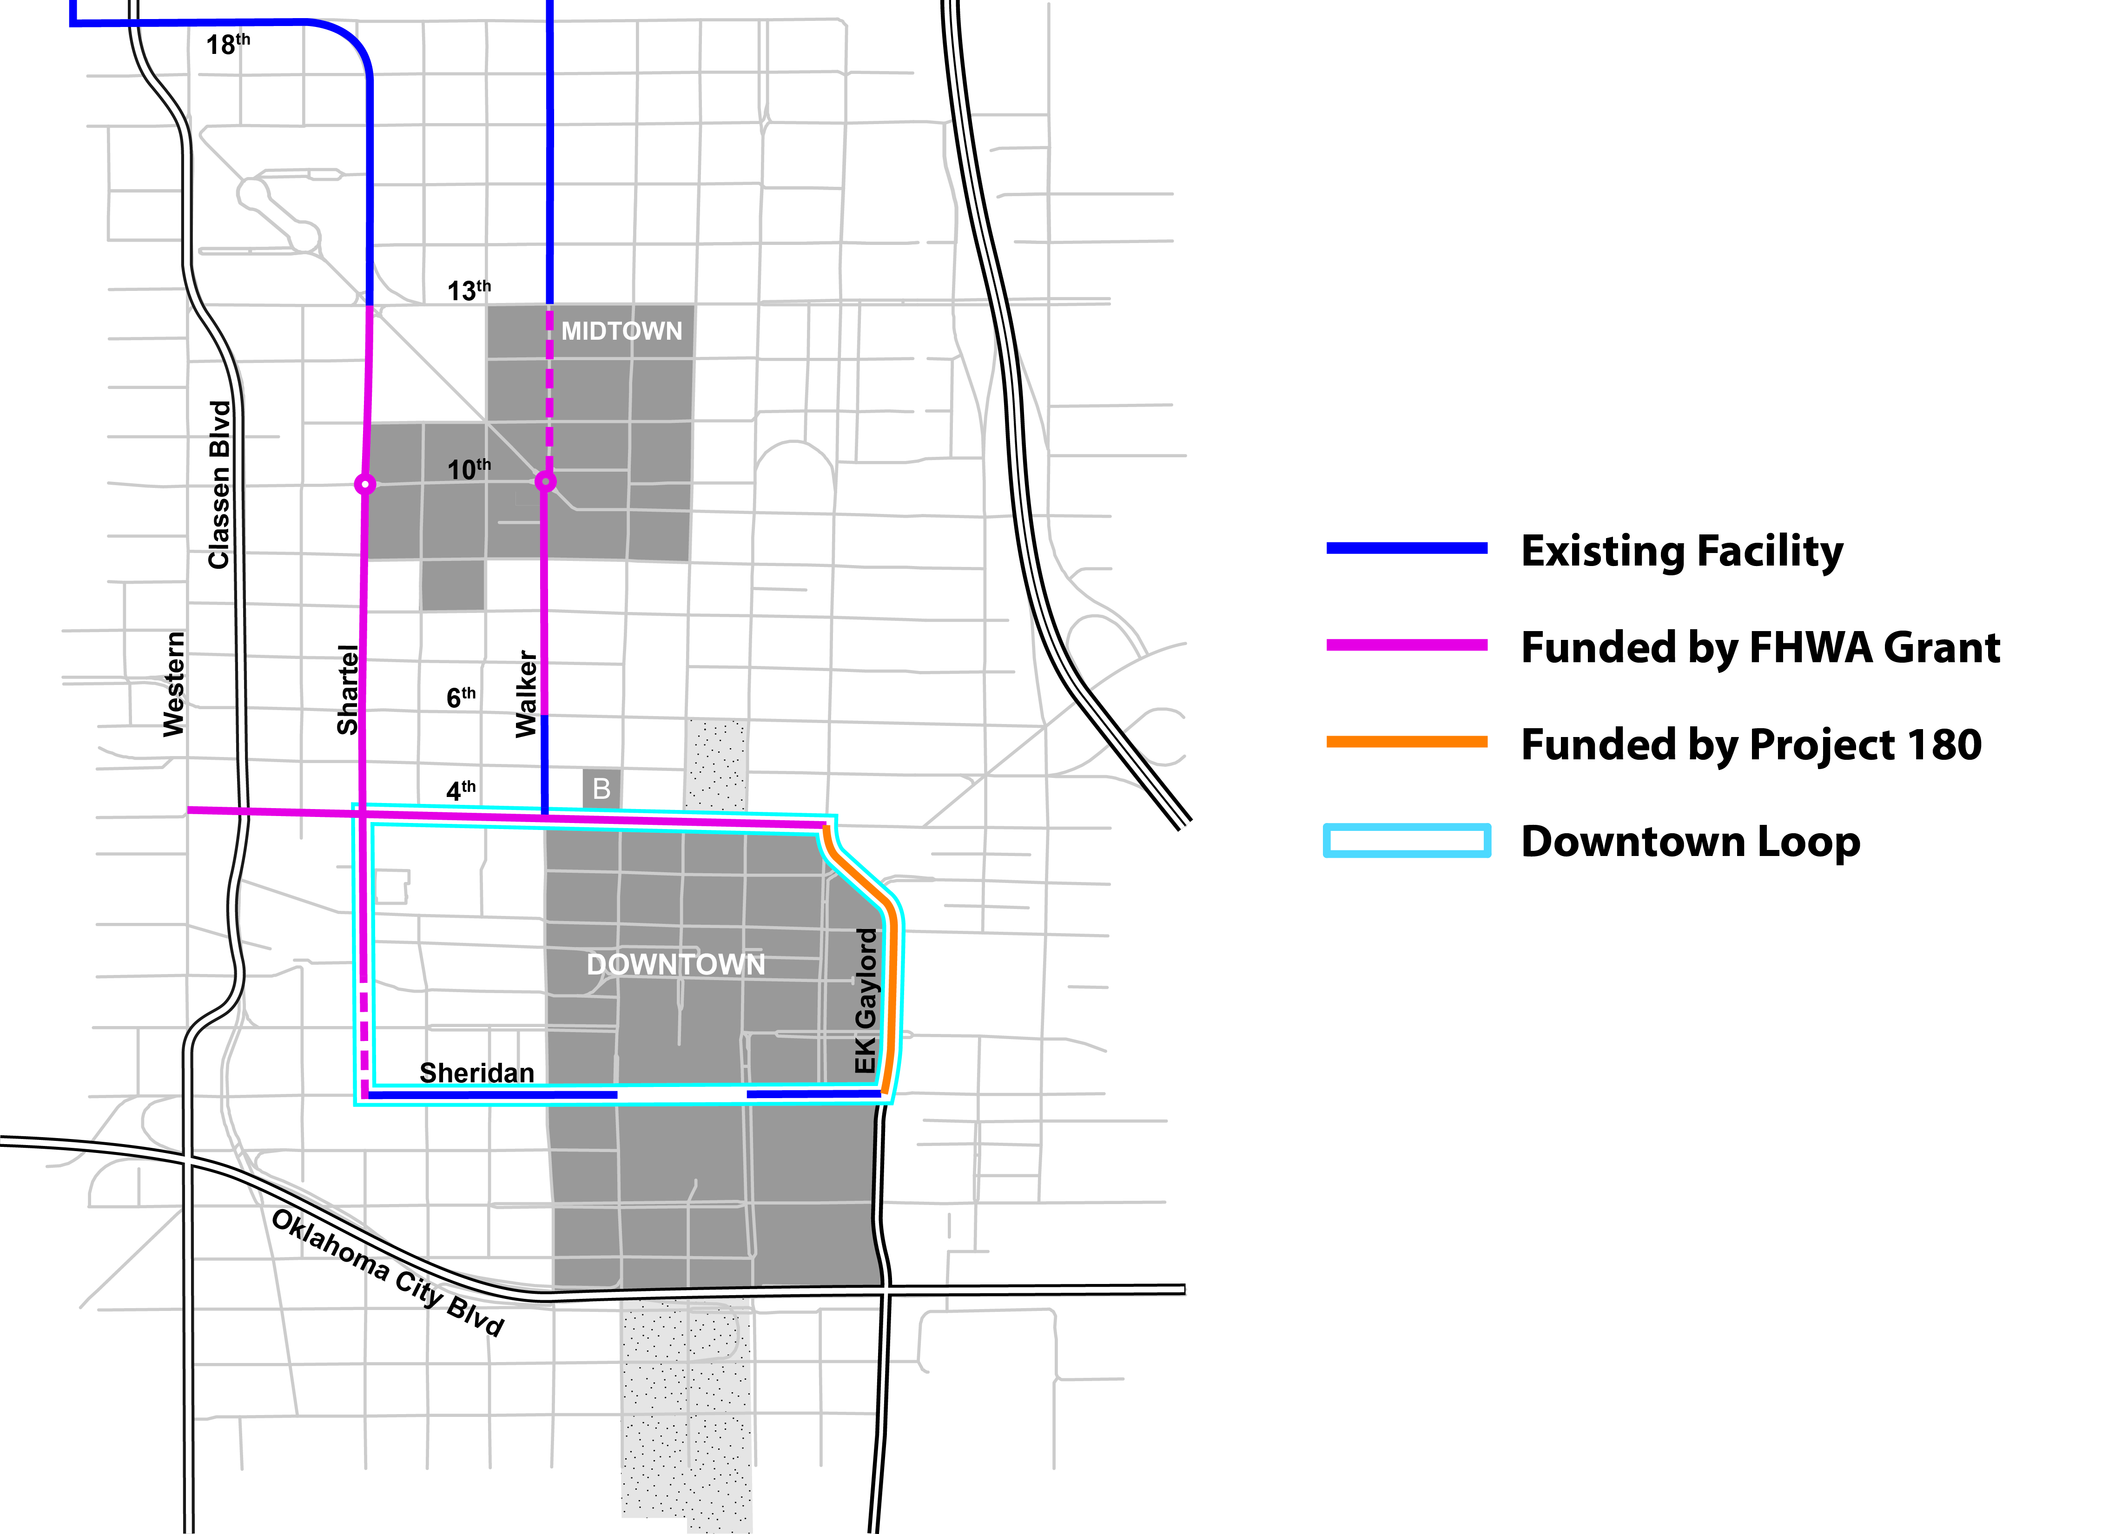
DEMONSTRATION CORRIDORS

Slide 52
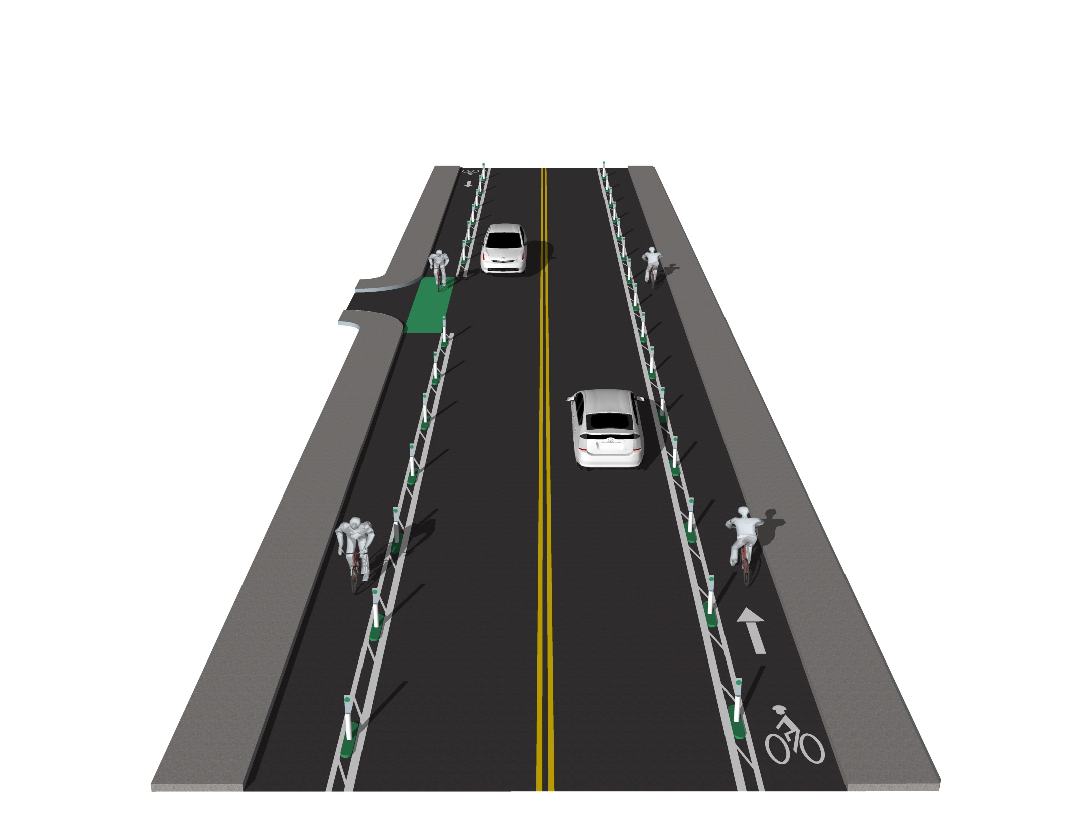
DEMONSTRATION CORRIDORS

Slide 53
QUESTIONS?

